Slide 1
Qt Training – QML Edition
March 2018
Based on Qt 5.10
N.N.
N.N@company.com

Slide 2
Contents
Introduction to QtQuick and QML | Meet Qt Quick Concepts
Composing Uis | Nested Items Graphical QML Types Text Type Anchor Layout
User Interactions | Mouse Input Touch Input Keyboard Input Pointer Handlers
Structures | Components Modules
States and Transitions | States State Machine State Conditions Transitions

Slide 3
Contents
Animations | Animations Easing Curves Animation Groups
Presenting Data | Arranging Items Data Models Using Views XML Models Views Revisited
QtQuick Controls | Qt Quick Designer Qt Quick Controls Application Window Controls and Views Styling
Multimedia | Media Player Camera Other Features Audio Engine

Slide 4
Contents
C++ Integration | Declarative Environment Exporting C++ Objects to QML Exporting Classes to QML Exporting Non-GUI Classes Exporting QPainter based GUI Classes Exporting Scene Graph -based GUI Classes Using Custom Types Plug-ins
Graphics Effects | Canvas Shapes Particles Shaders

Slide 5
Introduction to QtQuick and QML

Slide 6
Contents
Meet Qt Quick
Concepts

Slide 7
Objectives
Understanding of QML syntax and concepts
QML types and identities
Properties and property binding
Basic user interface composition skills
Familiarity with common QML types
Understanding of anchors and their uses
Ability to reproduce a design

Slide 8
Qt Quick Requirements
Graphics API for rendering
OpenGL ES 2.0 or higher
Qt Quick 2D renderer for SW rendering
Direct3D 12
Other modules can be used to add new features:
Qt Graphical Effects: add effects like blur, dropnshadow...
Qt 3D: 3D simulations and games in QML
Qt Multimedia: audio and video items, camera
Qt WebEngine / Qt WebView: web view
Qt Sensors: compass, orientation, tilt, proximity…
Qt Positioning and Location
Qt Bluetooth
…

Slide 9
Meet Qt Quick

Slide 10
What is Qt Quick?
A set of technologies including:
Declarative markup language: QML
Imperative Language: JavaScript
Language runtime integrated with Qt
C++ API for integration with Qt applications
QtCreator IDE support for the QML language
Qt Quick Designer
Debugger
QML Profiler
Qt Quick Application
GUI Thread
QML engine (extends JavaScript engine)
Manages QML types
Manages QML objects
Manages property bindings
Renderer Thread

Slide 11
Philosophy of Qt Quick
Intuitive User Interfaces
Design-Oriented
Rapid Prototyping and Production
Easy Deployment
Enable designer and developers to work on the same sources

Slide 12
Rapid Workflow with Qt Quick
Qt Quick
Declarative UI Design
Stunningly Fluent Modern User Interfaces, written with QML. Ideal for rapid UI prototyping.
Designer
Imperative Logic
Power of Cross-Platform Native Qt/C++
Developer
Core
Processes, Threads,
IPC, Containers,
I/O, Strings,
Etc.
Network
HTTP
FTP
SSL
Sql
SQL
&
Oracle
Databases
XML
Bluetooth
Positioning
NFC
Serial Port
+ Direct Hardware Access

Slide 13
Concepts

Slide 14
What Is QML?
Declarative language for User Interface building blocks
Describes the user interface
What UI building blocks look like
How they behave
UI specified as tree of QML objects with properties

Slide 15
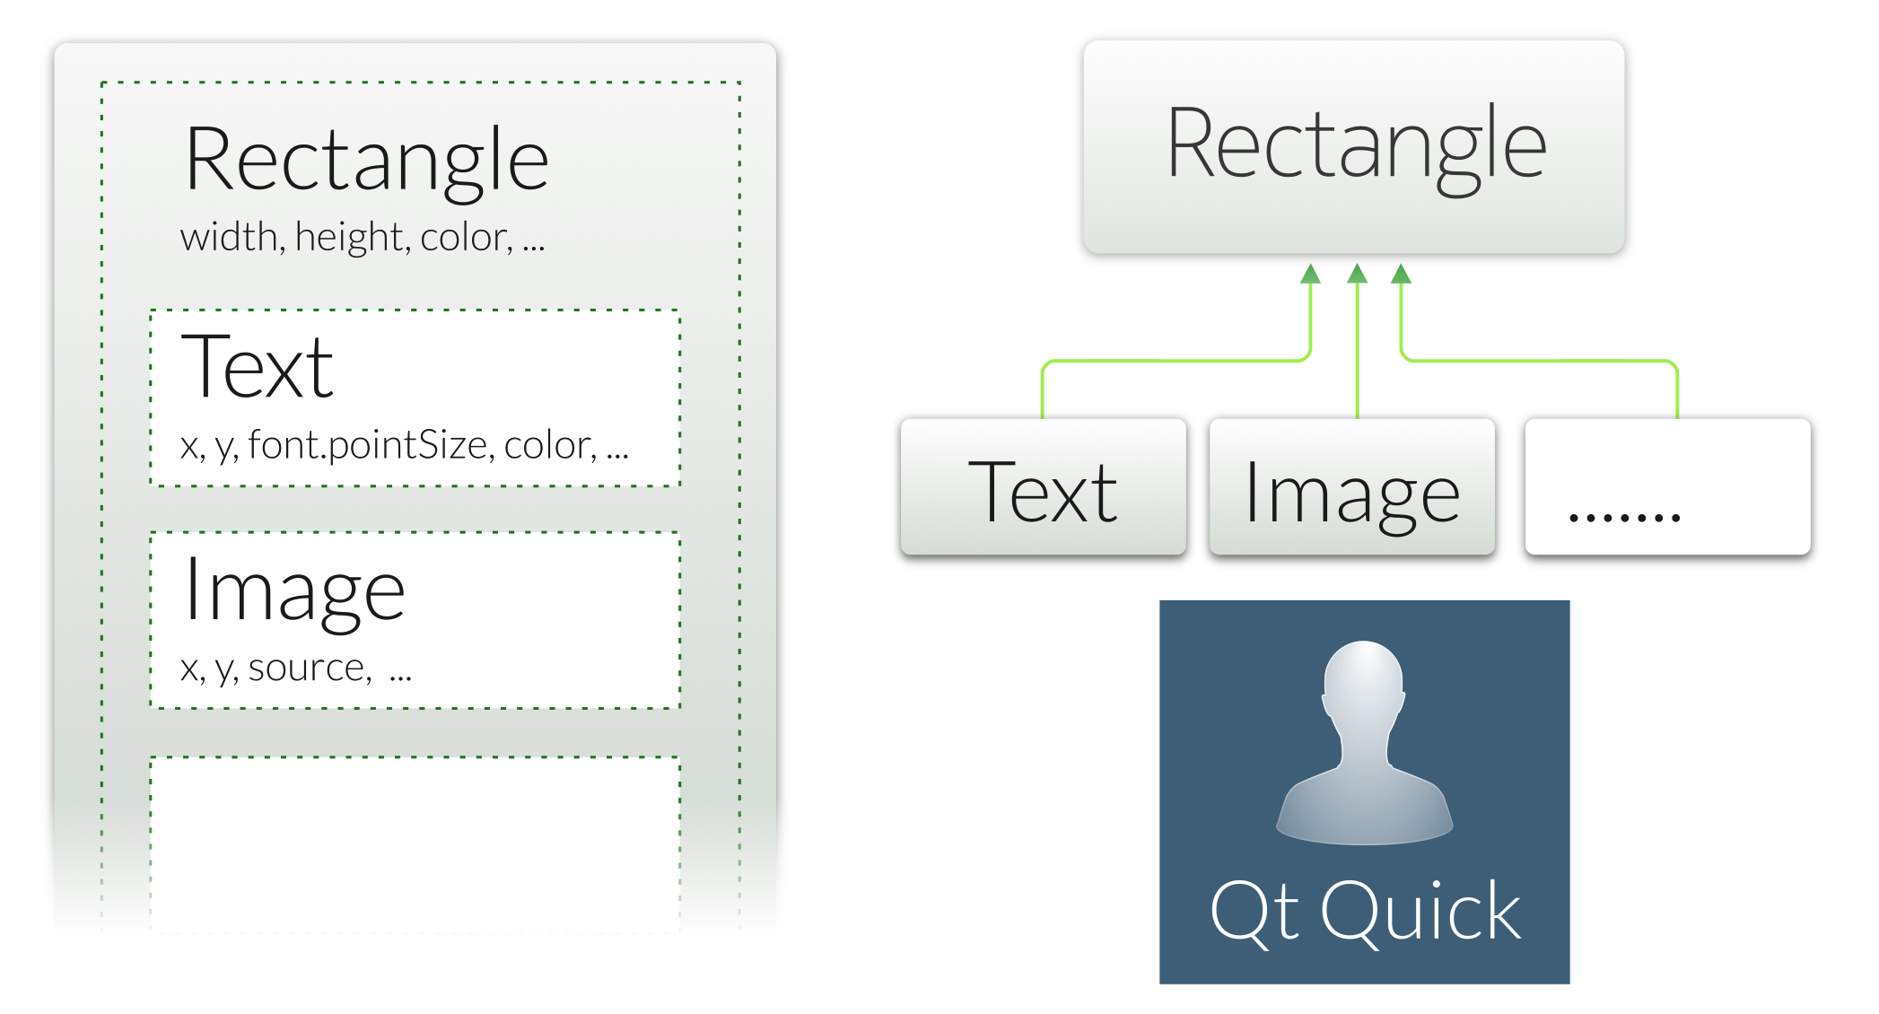
A Tree of QML Objects
Let's start with an example...

Slide 16
Viewing an Example
import QtQuick 2.9
Rectangle {
width: 400
height: 400
color: "lightblue"
}
Locate the example: rectangle.qml
Launch the QML runtime:
qmlscene rectangle.qml
Or open qml-intro.qmlproject in Qt Creator
Open rectangle.qml in editor
Click on the Run Button – qmlscene uses the current file as the main QML file
Demo: ex-concepts/rectangle.qml

Slide 17
QML Types
QML types are structures in the markup language
Represent visual and non-visual parts
Item is the base type of visual types
Not visible itself
Has a position, dimensions, focus
Supports layering
Usually used to group visual types
Rectangle, Text, TextInput,...
Non-visual QML types:
States, transitions,...
Models, paths,…
Gradients, timers, etc.
QML types contain properties
Can also be extended with custom properties
Documentation: Visual QML Types

Slide 18
Properties
QML types are described by properties:
Simple name-value definitions
width, height, color,…
With default values
Each has a well-defined type
Separated by semicolons or line breaks
Used for
Identifying QML objects (id property)
Customizing their appearance
Changing their behavior

Slide 19
Property Examples
Standard properties can be given values:
Grouped properties keep related properties together:
Identity property gives the object a name:
Identifying objects (id property)
Customizing their appearance
Changing their behavior
Text {
text: "Hello world"
height: 50
}
Text {
id: label
text: "Hello world"
}
Text {
font.family: "Helvetica"
font.pointSize: 24
// Preferred syntax
// font { family: "Helvetica"; pixelSize: 24 }
}

Slide 20
Property Examples
Attached properties are applied to QML objects without object creation:
KeyNagivation.tab is not a standard property of TextInput
Is a standard property that is attached to objects
Custom properties can be added to any object:
TextInput {
text: "Hello world"
KeyNavigation.tab: nextInput
}
Rectangle {
property real mass: 100.0
}
Circle {
property real radius: 50.0
}

Slide 21
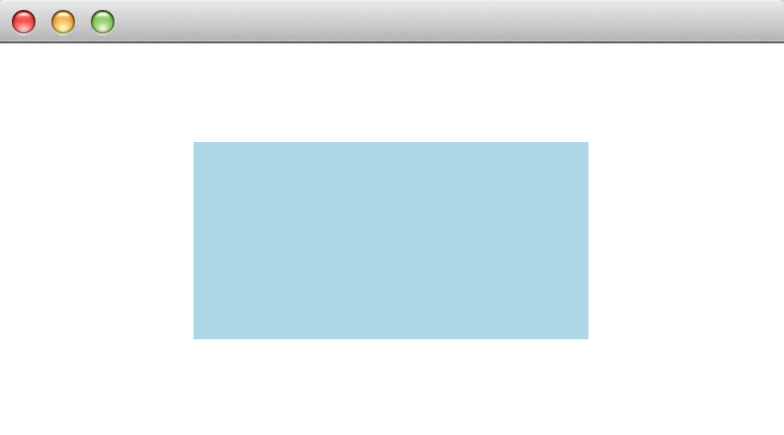
Binding Properties
Item {
width: 400; height: 200
Rectangle {
x: 100; y: 50; width: height * 2; height: parent.height / 2
color: "lightblue"
}
}
Properties can contain JavaScript expressions
See above: width is twice the height
Not just initial assignments
Expressions are re-evaluated when needed
Note! JavaScript assignment operator ‘=‘ is not a binding
Assignment: width = height * 2 // No re-evaluation
Assignment to a binding: width = Qt.binding(function() { return height * 2; } )
qml-intro/ex-concepts/expressions.qml

Slide 22
Identifying Objects
The id property defines an identity for a QML object
Lets other objects refer to it
For relative alignment and positioning
To use its properties
To change its properties (e.g., for animation)
For re-use of common types (e.g., gradients, images)
Used to create relationships between objects
Documentation: Property binding

Slide 23
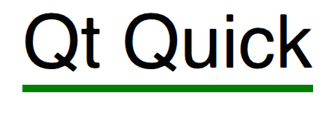
Using Identities
Item {
width: 300; height: 115
Text {
id: title
x: 50; y: 25
text: "Qt Quick"
font { family: "Helvetica"; pointSize: parent.width * 0.1 }
}
Rectangle {
x: title.x; y: title.y + title.height - height; height: 5
width: title.width
color: "green"
}
}
qml-intro/ex-concepts/identity.qml

Slide 24
Viewing an Example
Text {
id: title
x: 50; y: 25
text: "Qt Quick"
font { family: "Helvetica"; pointSize: parent.width * 0.1 }
}
Rectangle {
x: title.x; y: title.y + title.height - height; height: 5
width: title.width
color: "green"
}
Text item has the identity, title
Properties width, x, y of Rectangle bound to width of title

Slide 25
Basic Types
Property values can have different types:
Numbers (int and real): 400 and 1.5
Boolean values: true and false
Strings: “HelloQt”
Constants: AlignLeft
Lists:[...]
One item lists do not need brackets
Scripts:
Included directly in property definitions
Other types:
colors, dates, rects, sizes, 3Dvectors,...
Usually created using constructors
Documentation: QML types

Slide 26
QML File Structure
Identifier
Property declarations
Signal declarations
JavaScript functions
Object properties
Child objects
States
Transitions
Item {
id: exampleItem
property var exampleProperty: ListView.view
signal exampleSignal(var variantArgument)
function example() { return 0; }
width: window.width; height: window.height
Text { }
states: [ State {} ]
transitions: [ Transition {} ]

Slide 27
Questions
How do you load a QML module?
What is the difference between Rectangle and width?
How would you create an object with an identity?
What syntax do you use to refer to a property of another object?

Slide 28
Summary
QML defines user interfaces using QML types and properties
Types are the structures in QML source code
Items are visual types
Standard types contain properties and methods
Properties can be changed from their default values
Property values can be JavaScript expressions
id properties give identities to objects
Properties are bound together
When a property changes, the properties that reference it are updated
Some standard types define methods
A range of built-in types is provided

Slide 29
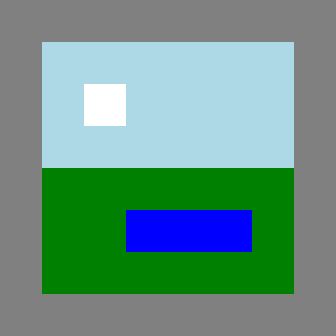
Lab – Nested Items
The image on the right shows two items and two child items inside a 400 × 400 rectangle.
Recreate the scene using Rectangle items. Make item sizes scalable. Positions can be fixed.
Can items overlap? Experiment by moving the light blue or green rectangles.
Can child items be displayed outside their parents? Experiment by giving one of the child items negative coordinates.

Slide 30
Composing UIs

Slide 31
Contents
Nested Items
Graphical QML Types
Text Type
Anchor Layout

Slide 32
Objectives
Items are often nested
One item contains others
Manage collections of items
Colors, gradients and images
Create appealing UIs
Text
Displaying text
Handling text input
Anchors and alignment
Allow items to be placed in an intuitive way
Maintain spatial relationships between items

Slide 33
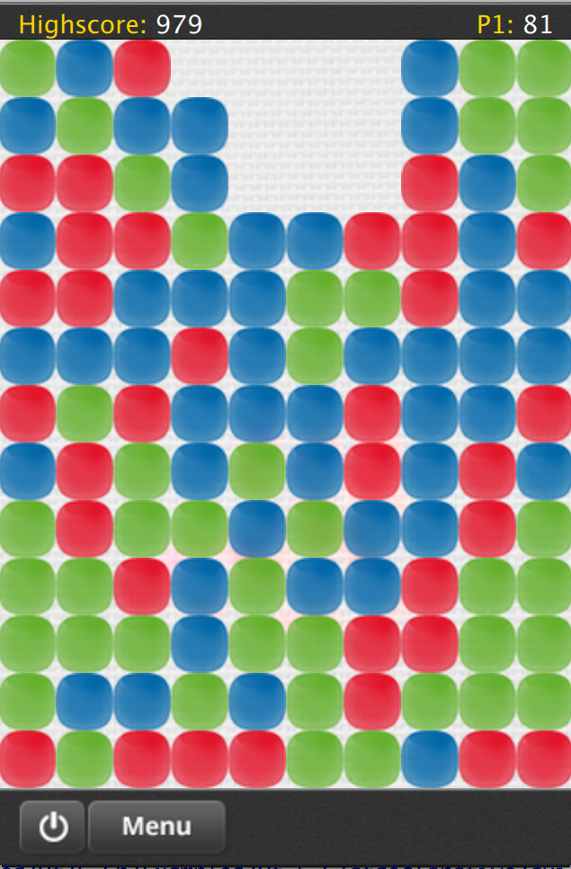
Why Use Nested Items, Anchors and Components?
Concerns separation
Visual grouping
Pixel perfect items placing and layout
UI scaling
Encapsulation
Reusability
Look and feel changes
Demo: Qt Quick Demo . Same Game

Slide 34
Nested Items

Slide 35
Nested Items
Rectangle {
width: 400; height: 400
color: "lightblue”
Rectangle {
x: 50; y: 50
width: parent.width - 2 * x; height: parent.height - 2 * y
color: "green”
Rectangle {
x: parent.width - 2 * width; y: parent.height - 3 * height
width: 50; height: 50
color: "white"
}
}
}
Each item positioned relative to its parents
qml-composing-uis/ex-elements/nested2.qml

Slide 36
Graphical QML Types

Slide 37
Colors
Specifying colors
Named colors (using SVG names): "red", "green", "blue",...
HTML style color components: "#ff0000", "#008000", "#0000ff",...
Built-in function: Qt.rgba(0,0.5,0,1)
Changing items opacity:
Using the opacity property
Values from 0.0 (transparent) to 1.0 (opaque)
Documentation: QML basic type colors

Slide 38

Colors
Rectangle {
id: rectangle1
x: 0; y: 0;
width: parent.width / 3; height: parent.height; color: "#ff0000"
}
Rectangle {
id: rectangle2
x: rectangle1.width; width: parent.width / 3
height: parent.height
color: Qt.rgba(0,0.75,0,1)
}
Rectangle {
x: rectangle1.width + rectangle2.width;
width: parent.width / 3;
height: parent.height;
color: "blue"
}
qml-composing-uis/ex-elements/colors.qml

Slide 39
Images
Represented by the Image QML type
Refer to image files with the source property
Using absolute URLs
Or relative to the QML file
Can be transformed
scaled, rotated
About an axis or central point
Asynchronous/synchronous loading
Loading ETC1 and ETC2 compressed textures from .pkm files supported

Slide 40
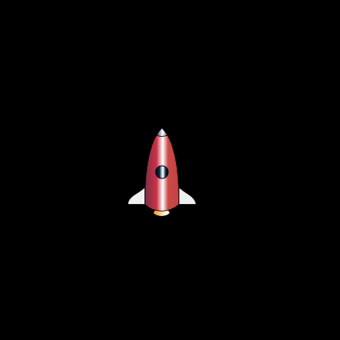
Images
aRectangle {
width: 400; height: 400
color: "black" Image {
x: (parent.width - width) / 2
y: (parent.height - height) / 2
source: "../images/rocket.png"
}
}
Property source contains a relative path
Properties width and height are obtained from the image file
qml-composing-uis/ex-elements/images.qml

Slide 41
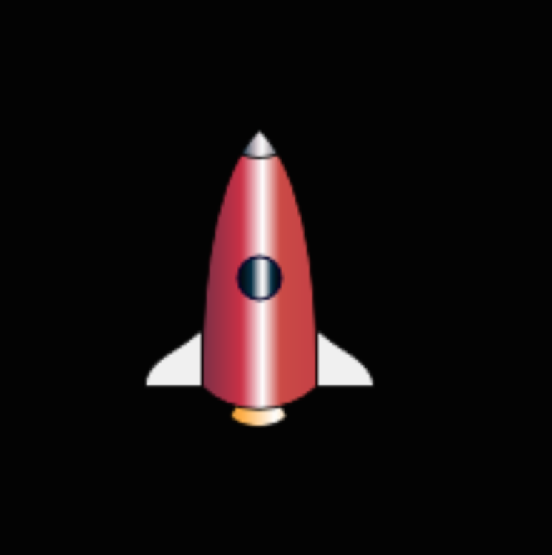
Image Scaling
Rectangle {
width: 400; height: 400
color: "black"
Image {
x: (parent.width - width) / 2
y: (parent.height - height) / 2
source: "../images/rocket.png"
scale: 2.0
}
Property source contains a relative path
Properties width and height are obtained from the image file
Image has non-zero implicit size – pixel dimension
Explicit size can override implicit size
Properties sourceWidth and sourceHeight define image size in memory
qml-composing-uis/ex-elements/image-scaling.qml

Slide 42

Image Rotation
Rectangle {
width: 200; height: 200; color: "black" Image {
x: (parent.width - width) / 2;
y: (parent.height - height) / 2
source: "../images/rocket.png"
rotation: 45.0
}
}
Set the rotate property
By default, the center of the item remains in the same place
qml-composing-uis/ex-elements/image-rotation.qml

Slide 43

Image Rotation
Rectangle {
width: 200; height: 200; color: "black" Image {
x: (parent.width - width) / 2;
y: (parent.height - height) / 2
source: "../images/rocket.png"
rotation: 45.0
transformOrigin: Item.Top
}
}
Set the transformOrigin property
Now the image rotates about the top of the item

Slide 44
Gradients
Define a gradient using the gradient property:
With a Gradient QML type as the value
Containing GradientStop objects, each with
A position: a number between 0 (startpoint) and 1 (endpoint)
A color
The start and end points
Are on the top and bottom edges of the item
Cannot be repositioned
Gradients override color definitions
Alternative to gradients: A simple background image
Documentation: QML Gradient Type

Slide 45

Gradients
Rectangle {
width: 400; height: 400
gradient: Gradient {
GradientStop {
position: 0.0; color: "green"
}
GradientStop {
position: 1.0; color: "blue"
}
}
}
Note the definition of an item as a property value
Radial and conical gradients are available in QtGraphicalEffects module
qml-composing-uis/ex-elements/gradients.qml

Slide 46

Gradient Images
Rectangle {
property real margin: 25
width: 425; height: 200 Image {
id: image1
width: (parent.width - margin) / 2
height: parent.height
source: "../images/vertical-gradient.png"
} Image {
x: image1.width + margin
width: (parent.width - margin) / 2; height: parent.height
source: "../images/diagonal-gradient.png"
}
}
It is often faster to use images instead of real gradients
Artists can create the desired gradients
qml-composing-uis/ex-elements/image-gradients.qml

Slide 47
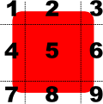
Border Images
Create border using part of an image:
Corners (region 1,3,7,9) are not scaled
Horizontal borders (2 and 8) are scaled according to horizontalTileMode
Vertical borders (4 and 6) are scaled according to verticalTileMode
Middle region (5) is scaled according to both modes
There are 3 different scale modes
Stretch: scale the image to fit to the available area.
Repeat: tile the image until there is no more space.
Round: like Repeat, but scales the images down to ensure that the last image is not cropped

Slide 48
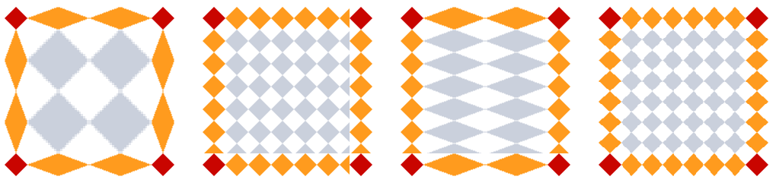
Border Images
BorderImage {
source: "content/colors.png"
border { left: 30; top: 30; right: 30; bottom: 30; }
horizontalTileMode: BorderImage.Stretch
verticalTileMode: BorderImage.Repeat
// ...
}
Demo: <Qt Examples>/declarative/imageelements/borderimage

Slide 49
Text Type

Slide 50
Text Type
Rectangle {
width: 400; height: 400; color: "lightblue" Text {
x: parent.width * 0.25; y: parent.height * 0.25
text: qsTr("Qt Quick”)
font { family: "Helvetica";
pixelSize: parent.width * 0.1 }
}
}
// fontSizeMode property is another way to do scaling
// fontInfo contains info about the actual font used
Width and height determined by the font metrics and text
Can also use HTML tags in the text:
"<html><b>Qt Quick</b></html>"
Rectangle size could depend on the font size
FontMetrics { id: metrics: font.family: “Courier” }
Rectangle { height: metrics.height * nofRows
qml-composing-uis/ex-elements/text.qml

Slide 51
TextInput
Rectangle {
width: 400; height: 400; color: "lightblue" TextInput {
x: parent.width * 0.25
y: parent.height * 0.25
width: parent.width * 0.75
text: qsTr("Editable text")
font { family: "Helvetica";
pixelSize: parent.height * 0.1 }
wrapMode: Text.WordWrap
}
}
No decoration (not a QLineEdit widget)
Gets the focus when clicked
Need something to click on
Property text changes as the user types
Method qsTr() marks the string translatable
qml-composing-uis/ex-elements/textInput.qml

Slide 52
Anchor Layout

Slide 53
Anchors
Used to position and align items
Line up the edges or central lines of items
Anchors refer to
Other items (centerIn, fill)
Anchors of other items (left, top)
Documentation: Positioning and anchors

Slide 54
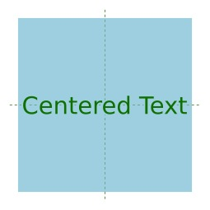
Anchors
Rectangle {
width: 400; height: 400
color: "lightblue"
id: rectangle1
Text {
text: qsTr("Centered text”); color: "green"
font { family: "Helvetica"; pixelSize: … }
anchors.centerIn: rectangle1
}
}
anchors.centerIn centers the Text item in the Rectangle
Refers to an item not an anchor
qml-composing-uis/ex-anchor-layout/anchors.qml

Slide 55
Anchors
Text {
text: qsTr("Centered text”)
color: "green"
font { family: "Helvetica"; pixelSize: … }
anchors.centerIn: parent
}
}
Each item can refer to its parent item
Using the parent ID
Can refer to ancestors and named children of ancestors
qml-composing-uis/ex-anchor-layout/anchors2.qml

Slide 56
Anchors
Text {
y: 34
text: qsTr("Right-aligned text”)
color: "green"
font { family: "Helvetica"; pixelSize: … }
anchors.right: parent.right
Connecting anchors together
Anchors of other items are referred to directly
Use parent.right
Not parent.anchors.right
qml-composing-uis/ex-anchor-layout/anchor-to-anchor.qml

Slide 57
Margins
Used with anchors to add space
Specify distances
In pixels
Between items connected with anchors

Slide 58
Margins
Rectangle {
width: 400; height: 200; color: "lightblue"
Image {
id: book; source: "../images/book.svg"
anchors.left: parent.left
anchors.leftMargin: parent.width / 16
anchors.verticalCenter: parent.verticalCenter
} Text {
text: qsTr("Writing”); font.pixelSize: 32
anchors.left: book.right anchors.leftMargin: 32
anchors.baseline: book.verticalCenter
}
}
qml-composing-uis/ex-anchor-layout/alignment.qml

Slide 59
Hints and Tips
Anchors can only be used with parent and sibling items
Anchors work on constraints
Some items need to have well-defined positions and sizes
Items without default sizes should be anchored to fixed or well-defined Items
Anchors create dependencies on geometries of other items
Creates an order in which geometries are calculated
Avoid creating circular dependencies
e.g.,parent → child→parent
Margins are only used if the corresponding anchors are used
e.g., leftMargin needs left to be defined

Slide 60
Strategies for Use
Identify item with different roles in the user interface:
Fixed items
Make sure these have id properties defined
Unless these items can easily be referenced as parent items
Items that dominate the user interface
Make sure these have id properties defined
Items that react to size changes of the dominant items
Give these anchors that refer to the dominator fixed items

Slide 61
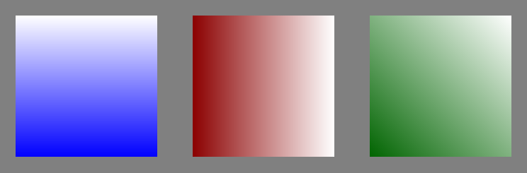
Lab – Color and Gradients
How else can you write these colors?
"blue”
"#ff0000”
Qt.rgba(0,0.5,0,1)
How would you create these items using the gradient property?
The effect
Describe another way to create these gradients?

Slide 62
Lab – Images and Text
When creating an Image, how do you specify the location of the image file?
By default, images are rotated about a point inside the image. Where is this point?
How do you change the text in a Text QML type?

Slide 63
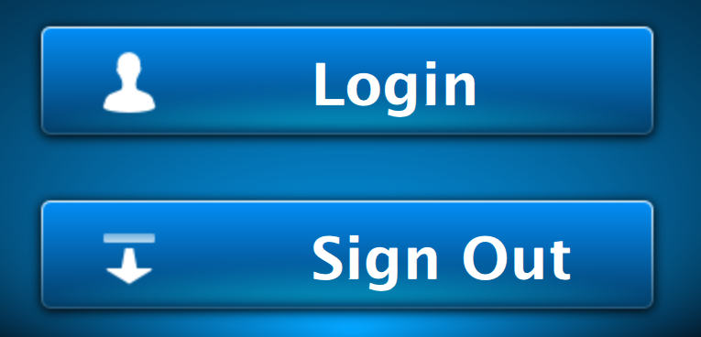


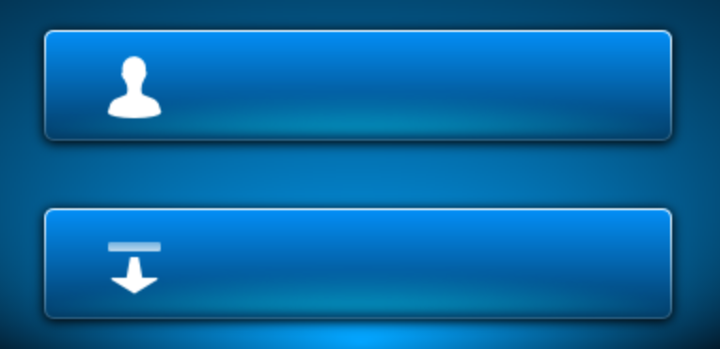
Lab – Images, Text, and Anchors
Create a user interface similar to the one shown above.
Hint: Use the background image supplied in the common images directory.
qml-composing-uis/lab-text-images-anchors

Slide 64
User Interactions

Slide 65
Contents
Mouse Input
Touch Input
Keyboard Input

Slide 66
Objectives
Knowledge of ways to receive user input
Mouse/touch input
Keyboard input
Awareness of different mechanisms to process input
Signal handlers
Property bindings
Demo: <Qt Examples>/declarative/toys/corkboards

Slide 67
Mouse Input

Slide 68
Mouse Areas
Placed and resized like ordinary items
Using anchors if necessary
Two ways to monitor mouse input:
Handle signals
Dynamic property bindings
Documentation: MouseArea QML Type

Slide 69
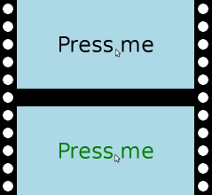
Clickable Mouse Area
Rectangle {
width: 400; height: 200; color: "lightblue”
Text {
anchors.horizontalCenter: parent.horizontalCenter
anchors.verticalCenter: parent.verticalCenter
text: qsTr("Press me”); font.pixelSize: 48
MouseArea {
anchors.fill: parent
onPressed: parent.color = "green"
onReleased: parent.color = "black"
}
}
}
qml-user-interaction/ex-mouse-input/mouse-pressed-signals.qml

Slide 70
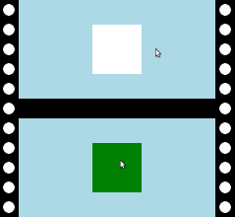
Mouse Hover and Properties
Rectangle {
width: 400; height: 200; color: "lightblue”
Rectangle {
x: 150; y: 50; width: 100; height: 100
color: mouseArea.containsMouse ? "green" : "white”
MouseArea {
id: mouseArea
anchors.fill: parent
hoverEnabled: true
}
}
}
qml-user-interaction/ex-mouse-input/hover-property.qml

Slide 71
Mouse Area Hints and Tips
A mouse area only responds to its acceptedButtons
The handlers are not called for other buttons, but
Any click involving an allowed button is reported
The pressedButtons property contains all buttons
Even non-allowed buttons, if an allowed button is also pressed
With hoverEnabled set to false
Property containsMouse can be true if the mouse area is clicked

Slide 72
Signals vs. Property Bindings
Signals can be easier to use in some cases
When a signal only affects one other item
Property bindings rely on named objects
Many items can react to a change by referring to a property
Use the most intuitive approach for the use case
Favor simple assignments over complex scripts

Slide 73
Touch Input

Slide 74
Touch Events
Single-touch (MouseArea)
Multi-touch (MultiPointTouchArea)
Gestures
Tap and Hold
Swipe
Pinch

Slide 75
Multi-Touch Events
MultiPointTouchArea {
anchors.fill: parent
touchPoints: [
TouchPoint { id: point1 },
TouchPoint { id: point2 },
TouchPoint { id: point3 }
]
}
TouchPoint properties:
real x, y
real prviousX, previousY
bool pressed
int pointId
real pressure

Slide 76
MultiPointTouchArea Signals
onPressed(list<TouchPoint> touchPoints)
onReleased( ...)
touchPoints is list of changed points.
onUpdated(…)
Called when points is updated (moved)
touchPoints is list of changed points.
onTouchUpdated(...)
Called on any change
touchPoints is list of all points.

Slide 77
MultiPointTouchArea Signals
onGestureStarted(GestureEvent gesture)
Cancel the gesture using gesture.cancel()
onCanceled(list<TouchPoint> touchPoints)
Called when another item takes over touch handling.
Useful for undoing what was done on onPressed.
qml-user-interaction/ex-multi-touch/main.qml

Slide 78
Gestures
Tap and Hold (MouseArea signal onPressAndHold)
Swipe (ListView)
Pinch (PinchArea)

Slide 79
Swipe Gestures
Build into ListView
snapMode: ListView.SnapOneItem The view settles no more than one item away from the first visible item at the time the mouse button is released.
orientation: ListView.Horizontal
Demo: <Qt Examples>/declarative/toys/corkboards

Slide 80
Pinch Gesture
Automatic pinch setup using the target property:
Image {
source: "qt-logo.jpg”
PinchArea {
anchors.fill: parent
pinch.target: parent
pinch.minimumScale: 0.5; pinch.maximumScale: 2.0
pinch.minimumRotation: -3600; pinch.maximumRotation: 3600
pinch.dragAxis: Pinch.XAxis
}
}
qml-user-interaction/ex-pinch

Slide 81
Pinch Gestures
Signals for manual pinch handling
onPinchStarted(PinchEventpinch)
onPinchUpdated(PinchEventpinch)
onPinchFinished()
PinchEvent properties:
point1, point2, center
rotation
scale
accepted
set to false in the onPinchStarted handler if the gesture should not be handled

Slide 82
Pointer Handlers
Handling multiple events in several items at the same time is not straightforward
Having several MouseArea objects would not work
One area grabs all touch/mouse events
Challenging to tap and drag at the same time
MultiPointTouchArea would require some logic to handle multiple touch points
Pointer handlers allow multiple items to track multiple fingers or any pointer devices at the same time
Lightweight compared to area-based items
Allows handling touch input from multiple screens
Enables using multiple camera sensors to recognize camera gestures

Slide 83
Pointer Handlers
Rectangle {
id: rectangle
width: 100 height: 100
anchors.centerIn: parent
color: "lightgreen"
PinchHandler {
id: handler
target: rectangle
} }

Slide 84
Keyboard Input

Slide 85
Keyboard Input
Basic keyboard input is handled in two different use cases:
Accepting text input
QML types TextInput and TextEdit
Navigation between items
Changing the focused item
directional(arrow keys), tab and backtab

Slide 86
Assigning Focus
Uis with just one TextInput
Focus assigned automatically
More than one TextInput
Need to change focus by clicking
What happens if a TextInput has no text?
No way to click on it
Unless it has a width or uses anchors
Set the focus property to assign focus

Slide 87
Using TextInputs
TextInput {
id: upperTextInput
anchors.left: parent.left
anchors.right: parent.right
text: "Field 1"; font.pixelSize: 32
color: focus ? "black" : "gray"
text: qsTr("Field") }
TextInput {
anchors.left: parent.left
anchors.top: upperTextInput.bottom
anchors.right: parent.right
text: qsTr("Field 2”); font.pixelSize: 32
color: focus ? "black" : "gray"
}
qml-user-interaction/ex-key-input/textinputs.qml

Slide 88
Focus Navigation
TextInput {
id: nameField
focus: true
KeyNavigation.tab: addressField
}
TextInput {
id: addressField
KeyNavigation.backtab: nameField
}
The name_field item defines KeyNavigation.tab
Pressing Tab moves focus to the address_field item
The address_field item defines KeyNavigation.backtab
Pressing Shift+Tab moves focus to the name_field item
qml-user-interaction/ex-key-input/tab-navigation.qml

Slide 89
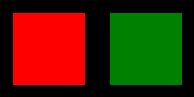
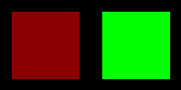
Key Navigation
Rectangle { id: leftRect
anchors { top: … }
color: focus ? "red" : "darkred"
KeyNavigation.right: rightRect
focus: true
}
Rectangle { id: rightRect
anchors { top: … }
color: focus ? "#00ff00" : "green"
KeyNavigation.left: leftRect
}
Using cursor keys with non-text items
Non-text items can have focus, too
qml-user-interaction/ex-key-input/key-navigation.qml

Slide 90
Summary
Mouse and cursor input handling:
QML type MouseArea receives clicks and other events
Use anchors to fill objects and make them clickable
Respond to user input:
Give the area a name and refer to its properties, or
Use handlers in the area and change other named items
Key handling:
QML types TextInput and TextEdit provide text entry features
Set the focus property to start receiving key input
Use anchors to make items clickable
Lets the user set the focus
QML type KeyNavigation defines relationships between items
Enables focus to be moved
Using cursor keys, tab and backtab
Works with non-text-input items

Slide 91
Lab – User Input
Which QML type is used to receive mouse clicks?
Name two ways TextInput can obtain the input focus.
How do you define keyboard navigation between items?

Slide 92

Lab – Menu Screen
Using the partial solution as a starting point, create a user interface similar to the one shown above with these features:
Items that change color when they have the focus
Clicking an item gives it the focus
The current focus can be moved using the cursor keys
qml-user-interaction/lab-menu-screen

Slide 93
Raw Keyboard Input
Raw key input can be handled by item
With predefined handlers for commonly used keys
Full key event information is also available
The same focus mechanism is used as for ordinary text input
Enabled by setting the focus property
Key handling is not an inherited property of items
Enabled using the Keys attached property
Key events can be forwarded to other objects
Enabled using the Keys.forwardTo attached property
Accepts a list of objects

Slide 94
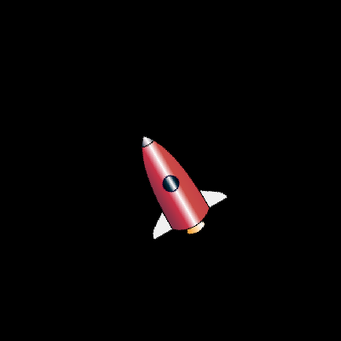
Raw Keyboard Input
Rectangle {
width: 400; height: 400; color: "black"
Image {
id: rocket
anchors.centerIn: parent
source: "../images/rocket.svg"
transformOrigin: Item.Center
}
Keys.onLeftPressed: rocket.rotation = (rocket.rotation - 10) % 360
Keys.onRightPressed: rocket.rotation = (rocket.rotation + 10) % 360
focus: true
}
qml-user-interaction/ex-key-input/key-press.qml

Slide 95
Raw Keyboard Input
Can use predefined handlers for arrow keys:
Keys.onLeftPressed: rocket.rotation = (rocket.rotation - 10) % 360
Keys.onRightPressed: rocket.rotation = (rocket.rotation + 10) % 360
Or inspect events from all key presses:
Keys.onPressed: {
if (event.key == Qt.Key_Left)
rocket.rotation = (rocket.rotation - 10) % 360;
else if (event.key == Qt.Key_Right)
rocket.rotation = (rocket.rotation + 10) % 360;
}

Slide 96
Focus Scopes
Focus scopes are used to manage focus for items
Property FocusScope delegates focus to one of its children
Useful, when several focusable instances created, e.g. button array
Without focus scope, the focus is given to the last instanced item
When the focus scope loses focus
Remembers which one has the focus
When the focus scope gains focus again
Restores focus to the previously active item
qml-user-interaction/ex-key-input/focus-scope.qml

Slide 97
QML Structures

Slide 98
Contents
Components
Modules

Slide 99
Objectives
Difference between Custom Items and Components
How to define Custom Items
How to define Components
Properties, Signal/Slots in Components
Grouping Components to Modules
Module Versioning
Using Namespaces

Slide 100
Components

Slide 101
Custom Items and Components
Two ways to create reusable user interface components:
Custom items
Defined in separate files
One main item per file
Used in the same way as standard items
Can have an associated version number
Components
Used with models and view
Used with generated content
Defined using the Component item
Used as templates for items

Slide 102
Defining a Custom Item
Rectangle {
border.color: "green"
color: "white"
radius: 4; smooth: true
TextInput {
anchors.fill: parent
anchors.margins: 2
text: qsTr("Enter text...”)
color: focus ? "black" : "gray"
font.pixelSize: parent.height - 4
}
}
Simple line edit
Based on undecorated TextInput
Stored in file LineEdit.qml
qml-modules/ex-modules-components/lineedit/LineEdit.qml

Slide 103
Using a Custom Item
Rectangle {
width: 400; height: 100; color: "lightblue"
LineEdit {
anchors.horizontalCenter: parent.horizontalCenter
anchors.verticalCenter: parent.verticalCenter
width: 300; height: 50
}
}
LineEdit.qml is in the same directory
Item within the file automatically available as LineEdit
qml-modules/ex-modules-components/lineedit/use-lineedit.qml

Slide 104
Adding Custom Properties
LineEdit does not expose a text property
The text is held by an internal TextInput item
Need a way to expose this text
Create a custom property
Syntax: property <type> <name>[: <value>]
property string product: "Qt Quick"
property int count: 123
property real slope: 123.456
property bool condition: true
property url address: "http://qt.io/"
Documentation: QML Object Attributes

Slide 105
Custom Property Example
Rectangle {
property string text: textInput.text // alias property preferred
…
TextInput {
id: textInput
…
text: qsTr("Enter text...”)
}
}
Custom text property binds to text_input.text
Setting the custom property
Changes the binding
No longer refer to text_input.text
qml-modules/ex-modules-components/custom-property/NewLineEdit.qml

Slide 106
Property Aliases
Rectangle {
property alias text: textInput.text
…
TextInput {
id: textInput
…
text: qsTr("Enter text...”)
}
}
Custom text property aliases text_input.text
Setting the custom property
Changes the TextInput's text
qml-modules/ex-modules-components/alias-property/AliasLineEdit.qml

Slide 107
Property Visibility Scope
Defines the visibility rules for properties
JavaScript has its own scope
QML does not interfere with that
Binding scope
Binding scope object’s properties may be accessed without qualification
Item {
function return2() {
var x = 2; // Does not interfere with item's x coordinate
return x;
}
Item {
property int aProperty: 120
x: aProperty // Item is a binding scope object
// Its properties can be accessed without qualification

Slide 108
Property Visibility Scope
Component scope
A union of object ids within the component and the component’s root object’s properties
Component instance hierarchy
Component instances can access the component scopes of their ancestors
delegate: Component {
Rectangle {
MouseArea {
anchors.fill: parent
console.log(qsTr("Item clicked"));
Repeater { // Example QML type, which has a Component delegate
delegate: Component {
Rectangle {
color: ancestorObjectId.color

Slide 109
Adding Custom Signals
Standard items define signals and handlers
e.g., MouseArea items can use onClicked
Custom items can define their own signals
Signal syntax: signal <name>[(<type> <value>, ...)]
Handler syntax: on<Name>: <expression>
Examples of signals and handlers:
Signal clicked
Handled by onClicked
Signal checked(bool checkValue)
Handled by onChecked
Argument passed as checkValue

Slide 110
Defining a Custom Signal
Item {
signal checked(bool checkValue)
…
MouseArea {
…
onClicked: if (parent.state == "checked") {
parent.state = "unchecked";
parent.checked(false);
} else {
parent.state = "checked";
parent.checked(true);
}
}
}
qml-modules/ex-modules-components/items/NewCheckBox.qml

Slide 111
Emitting a Custom Signal
Item {
signal checked(bool checkValue)
…
MouseArea {
…
onClicked: if (parent.state == "checked") {
parent.state = "unchecked";
parent.checked(false);
} else {
parent.state = "checked";
parent.checked(true);
}
}
}
MouseArea's onClicked handler emits the signal
Calls the signal to emit it

Slide 112

Receiving a Custom Signal
import "items"
Rectangle { width: 250; height: 100; color: "lightblue”
NewCheckBox {
anchors.horizontalCenter: parent.horizontalCenter
anchors.verticalCenter: parent.verticalCenter
onChecked: checkValue ? parent.color = "red"
: parent.color = "lightblue"
}
}
Signal checked is handled where the item is used
By the onCheckedhandler
on* handlers are automatically created for signals
Value supplied using name defined in the signal (checkValue)
qml-modules/ex-modules-components/use-custom-signal.qml

Slide 113
Modules

Slide 114
Modules
Modules hold collections of QML types:
Contain definitions of new types
Allow and promote re-use of types and higher level components
Versioned
Allows specific versions of modules to be chosen
Guarantees certain features/behavior
Import a directory name to import all modules within it
Documentation: QML Modules

Slide 115
Custom Item Revisited
Rectangle {
width: 400; height: 100; color: "lightblue”
LineEdit {
anchors.horizontalCenter: parent.horizontalCenter
anchors.verticalCenter: parent.verticalCenter
width: 300; height: 50
}
}
QML type LineEdit.qml is in the same directory
We would like to make different versions of this item so we need collections of items
qml-modules/ex-modules-components/lineedit/use-lineedit.qml

Slide 116
Collections of Items
import "items”
Rectangle {
width: 250; height: 100; color: "lightblue”
CheckBox {
anchors.horizontalCenter: parent.horizontalCenter
anchors.verticalCenter: parent.verticalCenter
}
}
Importing “items” directory
Includes all the files (e.g. items/CheckBox.qml)
Useful to organize your application
Provides the mechanism for versioning of modules
qml-modules/ex-modules-components/use-collection-of-items.qml

Slide 117
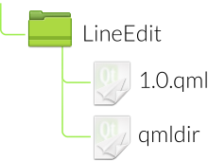
Versioning Modules
Create a directory called LineEdit containing
LineEdit-1.0.qml–implementation of the custom item
qmldir–version information for the module
The qmldir file contains a single line:
LineEdit 1.0 LineEdit-1.0.qml
Describes the name of the item exported by the module
Relates a version number to the file containing the implementation

Slide 118
Using a Versioned Module
import LineEdit 1.0
Rectangle {
width: 400; height: 100; color: "lightblue”
LineEdit {
anchors.horizontalCenter: parent.horizontalCenter
anchors.verticalCenter: parent.verticalCenter
width: 300; height: 50
}
}
Now explicitly import the LineEdit
Using a relative path
And a version number
qml-modules/ex-modules-components/versioned/use-lineedit-version.qml

Slide 119
Running the Example
Locate qml-modules-components/ex-modules-components
Launch the example:
qmlscene -I versioned versioned/use-lineedit-version.qml
Normally, the module would be installed on the system
Within the Qt installation's imports directory
So the -I option would not be needed for qmlscene

Slide 120
Supporting Multiple Versions
Imagine that we release version 1.1 of LineEdit
We need to ensure backward compatibility
LineEdit needs to include support for multiple versions
Version handling is done in the qmldir file
LineEdit 1.1 LineEdit-1.1.qml
LineEdit 1.0 LineEdit-1.0.qml
Each implementation file is declared
With its version
In decreasing version order (newer versions first)

Slide 121
Importing into a Namespace
import QtQuick 2.4 as MyQt
MyQt.Rectangle {
width: 150; height: 50; color: "lightblue”
MyQt.Text {
anchors.centerIn: parent
text: "Hello Qt!"
font.pixelSize: 32
}
}
import...as...
All items in the Qt module are imported
Accessed via the MyQt namespace
Allows multiple versions of modules to be imported
qml-modules/ex-modules-components/use-namespace-module.qml

Slide 122
Importing into a Namespace
import "items" as Items
Rectangle {
width: 250; height: 100; color: "lightblue”
Items.CheckBox {
anchors.horizontalCenter: parent.horizontalCenter
anchors.verticalCenter: parent.verticalCenter
}
}
Importing a collection of items from a path
Avoids potential naming clashes with items from other collections and modules
qml-modules/ex-modules-components/use-namespace.qml

Slide 123
States and Transitions

Slide 124
Contents
States
State Conditions
Transitions

Slide 125
Objectives
Can define user interface behavior using states and transitions:
Provides a way to formally specify a user interface
Useful way to organize application logic
Helps to determine if all functionality is covered
Can extend transitions with animations and visual effects
States and transitions are covered in the Qt documentation

Slide 126
States

Slide 127
States
States manage named items
Represented by the State QML type
Each item can define a set of states
With the states property
Current state is set with the state property
Properties are set when a state is entered
Can also modify anchors
Change the parents of items
Run scripts
Documentation: QML States

Slide 128

States Example
Rectangle {
width: 150; height: 250
Rectangle {
id: stopLight
x: 25; y: 15; width: 100; height: 100
}
Rectangle {
id: goLight
x: 25; y: 135; width: 100; height: 100
}
}
Prepare each item with an id
Set up properties not modified by states

Slide 129
Defining States
states: [
State {
name: "stop"
PropertyChanges { target: stopLight; color: "red" }
PropertyChanges { target: goLight; color: "black" }
},
State {
name: "go"
PropertyChanges { target: stopLight; color: "black" }
PropertyChanges { target: goLight; color: "green" }
}
]
Define states with names: “stop” and “go”
Set up properties for each state with PropertyChanges
Defining differences from the default values
qml-states-transitions/ex-states/states.qml

Slide 130
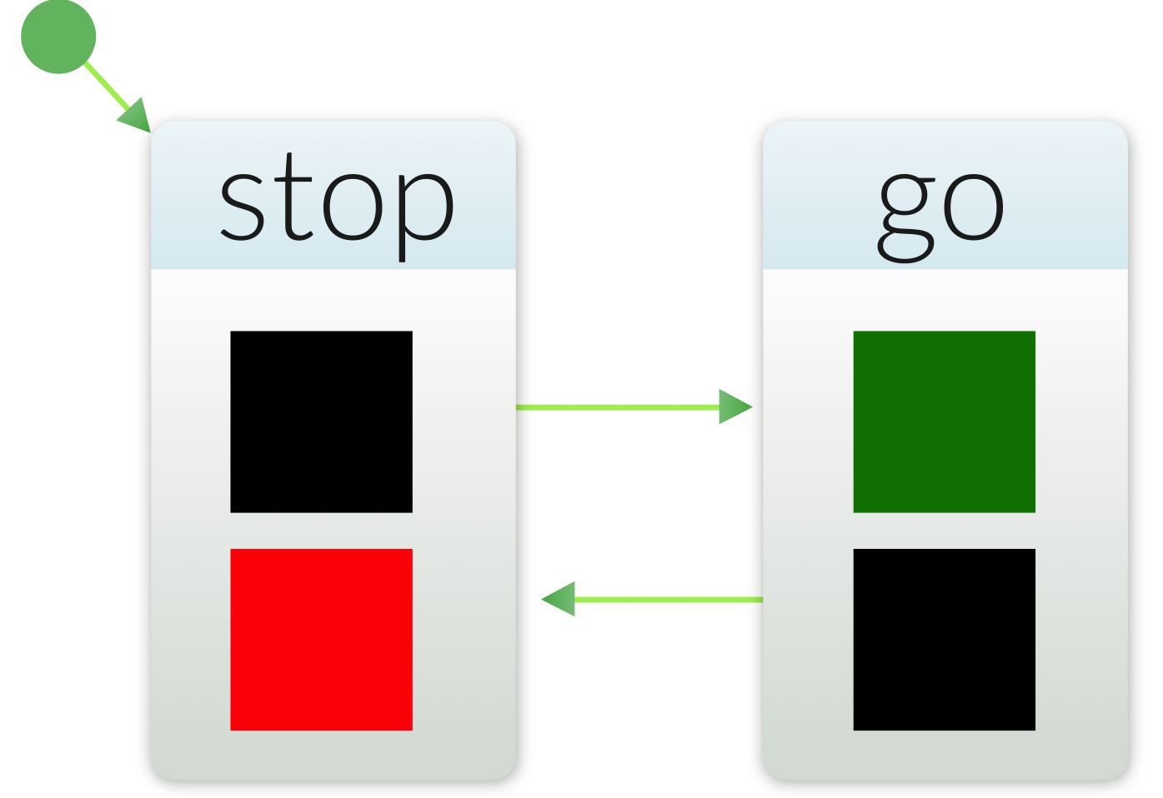
Setting the State
Define an initial state:
Use a MouseArea to switch between states:
Reacts to a click on the user interface
Toggles the parent's state property between “stop” and “go” states
state: "stop”
MouseArea {
anchors.fill: parent
onClicked: parent.state == "stop" ?
parent.state = "go" : parent.state = "stop"
}

Slide 131
Changing Properties
States change properties with the PropertyChanges QML type:
Acts on a target item named using the target property
The target refers to an id
Applies the other property definitions to the target item
One PropertyChanges instance can redefine multiple properties
Property definitions are evaluated when the state is entered
PropertyChanges describes new property values for an item
New values are assigned to items when the state is entered
Properties left unspecified are assigned their default values
State {
name: "go"
PropertyChanges { target: stopLight; color: "black” }
PropertyChanges { target: goLight; color: "green" }
}

Slide 132
State Machine
StateMachine
Inherits State
Hierarchical finite state machine
States: Initial state, final state, error state, history state
Transitions: Signal transition, timeout transition
Possible to set initial values for properties and restore them, if not set in an entered state
Controlled using globalRestorePolicy property
Runs, until a top-level final state reached
Emits finished() signal
Can be generated from the SCXML file

Slide 133
State Machine Example
import QtQml.StateMachine 1.0 as FSM
Window {
id: window
FSM.StateMachine {
id: stateMachine
initialState: running
running: true
FSM.State {
id: running
initialState: go
FSM.State {
id: go
FSM.TimeoutTransition {
targetState: leavingGo
timeout: 1000
}
onEntered: trafficLight.currentState = "go";
}
}
onStopped: Qt.quit()
qml-states-transitions/ex-states/states-machone.qml

Slide 134
State Conditions

Slide 135
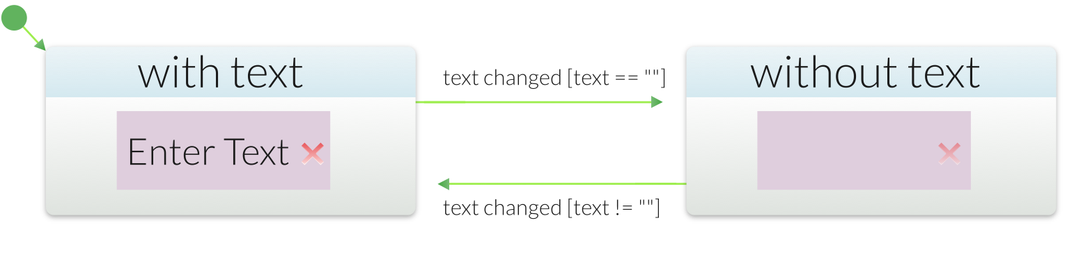
State Conditions
Another way to use states:
Let the State decide when to be active
Using conditions to determine if a state is active
Define the when property
Using an expression that evaluates to true or false
Only one state in a states list should be active
Ensure when is true for only one state
qml-states-transitions/ex-states/states-when.qml

Slide 136

State Conditions Example
TextInput { id: textField
text: "Enter text..."
… }
Image { id: clearButton
source: "../images/clear.svg”
…
MouseArea { anchors.fill: parent
onClicked: textField.text = "" }
}
Define default property values and actions

Slide 137

State Conditions Example
states: [
State {
name: "with text"
when: textField.text != ""
PropertyChanges {
target: clearButton; opacity: 1.0
}
},
State {
name: "without text"
when: textField.text == ""
PropertyChanges {
target: clearButton; opacity: 0.25 }
PropertyChanges {
target: textField; focus: true }
}
]
A clear button that fades out when there is no text
Do not need to define state

Slide 138
Transitions

Slide 139
Transitions
Define how items change when switching states
Applied to two or more states
Usually describe how items are animated
Let's add transitions to a previous example...
qml-states-transitions/ex-transitions/transitions.qml

Slide 140
Transitions Example
transitions: [
Transition {
from: "stop"; to: "go"
PropertyAnimation {
target: stopLight
properties: "color"; duration: 1000
}
},
Transition {
from: "go";
to: "stop"
PropertyAnimation {
target: goLight
properties: "color"; duration: 1000
}
}]
The transitions property defines a list of transitions
Transitions between “stop” and “go” states

Slide 141
Wildcard Transitions
transitions: [
Transition {
from: "*"; to: "*"
PropertyAnimation {
target: stopLight
properties: "color"; duration: 1000 }
PropertyAnimation {
target: goLight
properties: "color";
duration: 1000 }
} ]
Use “*” to represent any state
Now the same transition is used whenever the state changes
Both lights fade at the same time
qml-states-transitions/ex-transitions/transitions-multi.qml

Slide 142
Reversible Transitions
transitions: [
Transition {
from: "with text"; to: "without text"
reversible: true
PropertyAnimation {
target: clearButton
properties: "opacity";
duration: 1000
}
} ]
Useful when two transitions operate on the same properties
Transition applies from “with text” to “without text”
And back again from “without text” to “with text”
No need to define two separate transitions
qml-states-transitions/ex-transitions/transitions-reversible.qml

Slide 143
Parent Changes
states: State { name: "reanchored"
ParentChange {
target: myRect
parent: yellowRect
x: 60; y: 20 }
} transitions: Transition { ParentAnimation {
NumberAnimation {
properties: "x,y"
duration: 1000 }
}
}
Used to animate an item when its parent changes
QML type ParentAnimation applies only when changing the parent with ParentChange in a state change
qml-states-transitions/ex-animations/parent-animation.qml

Slide 144
Anchor Changes
states: State { name: "reanchored"
AnchorChanges {
target: myRect
anchors.left: parent.left
anchors.right : parent.right } } transitions: Transition { AnchorAnimation {
duration : 1000 }
}
Used to animate an item when its anchors change
QML type AnchorAnimation applies only when changing the anchors with AnchorChanges in a state change
qml-states-transitions/ex-animations/anchors-animation.qml

Slide 145
Using States and Transitions
Avoid defining complex state charts
Not just one state chart to manage the entire UI
Usually defined individually for each component
Link together components with internal states
Setting state with script code
Easy to do, but might be difficult to manage
Setting state with state conditions
More declarative style
Can be difficult to specify conditions
Using animations in transitions
Do not specify from and to properties
Use PropertyChanges in state definitions

Slide 146
Summary – States
State items manage properties of other items:
Items define states using the states property
Must define a unique name for each state
Useful to assign id properties to items
Use PropertyChanges to modify items
The state property contains the current state
Set this using JavaScript code, or
Define a when condition for each state

Slide 147
Summary – Transitions
Transition items describe how items change between states:
Items define transitions using the transitions property
Transitions refer to the states they are between
Using the from and to properties
Using a wildcard value, “*”, to mean any state
Transitions can be reversible
Used when the from and to properties are reversed

Slide 148
Questions – States and Transitions
How do you define a set of states for an item?
What defines the current state?
Do you need to define a name for all states?
Do state names need to be globally unique?
Remember the thumbnail explorer page? Which states and transitions would you use for it?

Slide 149
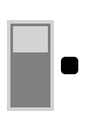
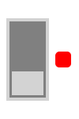
Lab – Light Switch
Using the partial solutions as hints, create a user interface similar to the one shown above.
Adapt the reversible transition code from earlier and add it to the example.
qml-states-transitions/lab-switch

Slide 150
Animations

Slide 151
Contents
Animations
Easing Curves
Animation Groups

Slide 152
Objectives
Can apply animations to user interfaces:
Understanding of basic concepts
Number and property animations
Easing curves
Ability to queue and group animations
Sequential and parallel animations
Pausing animations
Knowledge of specialized animations
Color and rotation animations

Slide 153
Animations

Slide 154
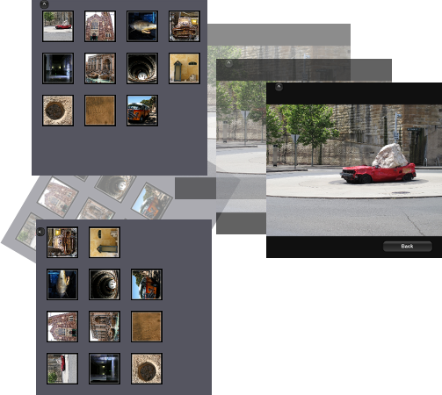
Why Use Animations, States and Transitions?
Handle form factor changes
Outline application state changes
Orchestrate high level logic
Natural transitions
Our brain expects movement
Helps the user find its way around the GUI
Don't abuse them!
qml-animations/ex-thumbnailexplorer/thumbnailexplorer.qml

Slide 155
Animations
Animations can be applied to any item
Animations update properties to cause a visual change
All animations are property animations
Specialized animation types:
NumberAnimation for changes to numeric properties
ColorAnimation for changes to color properties
RotationAnimation for changes to orientation of items
Vector3dAnimation for motion in 3D space
Easing curves are used to create variable speed animations
Animations are used to create visual effects
Documentation: Animations in QML

Slide 156
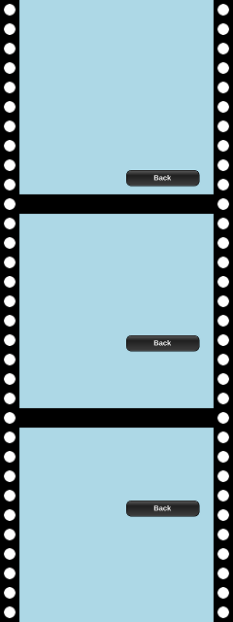
Number Animations
Rectangle {
width: 400; height: 400
color: "lightblue" Image {
x: 220 source: "../images/backbutton.png"
NumberAnimation on y {
from: 350; to: 150
duration: 1000
}
}
}
qml-animations/ex-animations/number-animation.qml

Slide 157
Number Animations
Number animations change the values of numeric properties
Applied directly to properties with the on keyword
The y property is changed by the NumberAnimation
Starts at 350
Ends at 150
Takes 1000 milliseconds
• Can also be defined separately
NumberAnimation on y {
from: 350;
to: 150
duration: 1000
}
qml-animations/ex-animations/number-animation.qml

Slide 158
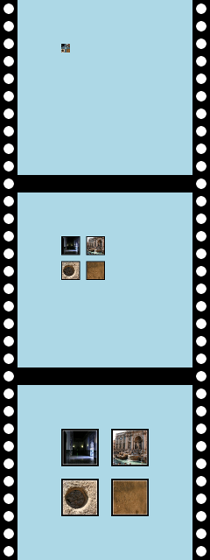
Property Animations
Rectangle {
width: 400;
height: 400;
color: "lightblue" Image {
id: image
x: 100; y: 100
source: "../images/thumbnails.png" } PropertyAnimation {
target: image
properties: "width,height"
from: 0; to: 200;
duration: 1000
running: true
}
}
}
qml-animations/ex-animations/property-animation.qml

Slide 159
Property Animations
Property animations change named properties of a target
Defined separately to the target item
Applied to properties of the target
Property properties is a comma-separated string list of names
Often used as part of a Transition
Not run by default
Set the running property to true
PropertyAnimation {
target: image
properties: "width,height"
from: 0; to: 200; duration: 1000
running: true }

Slide 160
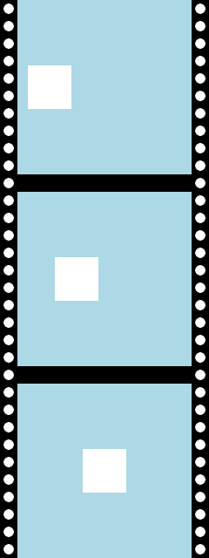
Number Animations Revisited
Rectangle {
width: 400; height: 400; color: "lightblue" Rectangle {
id: rect
x: 0; y: 150; width: 100; height: 100
} NumberAnimation {
target: rect
properties: "x"
from: 0; to: 150; duration: 1000
running: true
}
}
qml-animations/ex-animations/number-animation2.qml

Slide 161
Number Animations Revisited
Number animations are just specialized property animations
Animation can be defined separately
Applied to properties of the target
Property properties contains a comma-separated list of property names
Not run by default
Set the running property to true
NumberAnimation {
target: rect
properties: "x"
from: 0; to: 150; duration: 1000
running: true
}

Slide 162
The Behavior QML Type
Behavior allows you to set up an animation whenever a property changes.
Behavior on x {
SpringAnimation { spring: 1; damping: 0.2 }
}
Behavior on y {
SpringAnimation { spring: 2; damping: 0.2 }
}
qml-animations/ex-animations/spring-animation.qml

Slide 163
Easing Curves

Slide 164
Easing Curves
Rectangle {
width: 400; height: 400
color: "lightblue" Image {
x: 220
source: "../images/backbutton.png"
NumberAnimation on y {
from: 0; to: 350
duration: 1000
easing.type: "OutExpo"
}
} }
qml-animations/ex-animations/easing-curve.qml

Slide 165
Easing Curves
Apply an easing curve to an animation:
Sets the easing.type property
Relates the elapsed time
To a value interpolated between the from and to values
Using a function for the easing curve
In this case, the “OutExpo” curve
NumberAnimation on y {
from: 0; to: 350
duration: 1000
easing.type: "OutExpo"
}

Slide 166
Animation Groups

Slide 167
Sequential and Parallel Animations
Animations can be performed sequentially and in parallel
SequentialAnimation defines a sequence
With each child animation run in sequence
For example:
A rescaling animation, followed by an opacity changing animation
ParallelAnimation defines a parallel group
With all child animations run at the same time
For example:
Simultaneous rescaling and opacity changing animations
Sequential and parallel animations can be nested

Slide 168
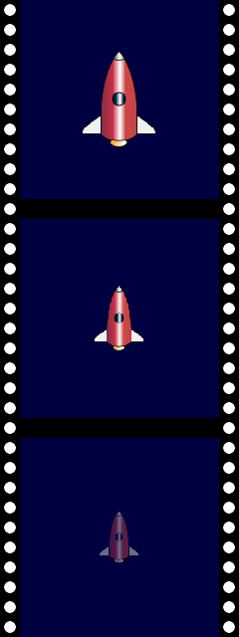
Sequential Animations
SequentialAnimation {
NumberAnimation {
target: rocket;
properties: "scale"
from: 1.0; to: 0.5; duration: 1000
}
NumberAnimation {
target: rocket;
properties: "opacity"
from: 1.0; to: 0.0; duration: 1000
}
running: true }
qml-animations/ex-animations/sequential-animation.qml

Slide 169
Sequential Animations
SequentialAnimation {
NumberAnimation {
target: rocket; properties: "scale"
from: 1.0; to: 0.5; duration: 1000
}
NumberAnimation {
target: rocket; properties: "opacity"
from: 1.0; to: 0.0; duration: 1000
}
running: true }
Child objects define a two-stage animation:
First ,the rocket is scaled down and then it fades out
SequentialAnimation does not itself have a target
It only groups other animations

Slide 170
Pausing between Animations
SequentialAnimation {
NumberAnimation {
target: rocket; properties: "scale"
from: 0.0; to: 1.0; duration: 1000
}
PauseAnimation { duration: 1000 }
NumberAnimation {
target: rocket; properties: "scale"
from: 1.0; to: 0.0; duration: 1000
}
running: true
}

Slide 171
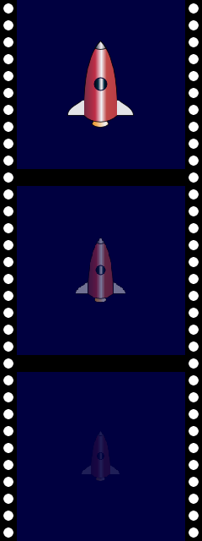
Parallel Animations
ParallelAnimation {
NumberAnimation {
target: rocket; properties: "scale"
from: 1.0; to: 0.5; duration: 1000
}
NumberAnimation {
target: rocket;
properties: "opacity"
from: 1.0; to: 0.0; duration: 1000
}
running: true
}
qml-animations/ex-animations/parallel-animation.qml

Slide 172
Other Animations
Other animations
ColorAnimation for changes to color properties
RotationAnimation for changes to orientation of items
Vector3dAnimation for motion in 3D space
AnchorAnimation animate an anchor change
ParentAnimation animates changes in parent values.
SpringAnimation allows a property to track a value in a spring-like motion
PropertyAction allows immediate property changes during animation
ScriptAction allows scripts to be run during an animation

Slide 173
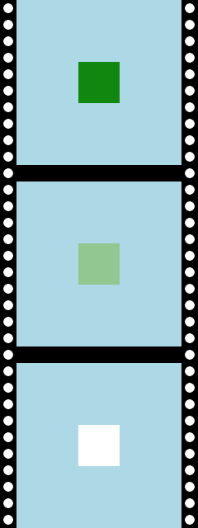
Color Animation
ColorAnimation describes color changes to items
Component-wise blending of RGBA values
ColorAnimation {
target: rectangle1
property: "color"
from: Qt.rgba(0,0.5,0,1)
to: Qt.rgba(1,1,1,1)
duration: 1000
running: true
}

Slide 174
Rotation Animation
RotationAnimation describes rotation of items
Easier to use than NumberAnimation for the same purpose
Applied to the rotation property of an item
Value of direction property controls rotation:
RotationAnimation.Clockwise
RotationAnimation.Counterclockwise
RotationAnimation.Shortest – the direction of least angle between from and to values

Slide 175

Rotation Animation
Image {
id: ball
source: "../images/ball.png"
anchors.centerIn: parent
smooth: true RotationAnimation on rotation {
from: 45; to: 315
direction: RotationAnimation.Shortest
duration: 1000
}
}
1 second animation
Counter-clockwise from 45° to 315°
Shortest angle of rotation is via 0°

Slide 176
Path Animation
QML type PathAnimation animates an item along a path
Manipulates the x, y and rotation properties of an item
The target QML type will be animated along the path
Value of orientation property controls the target rotation:
PathAnimation.Fixed
PathAnimation.RightFirst
PathAnimation.LeftFirst
PathAnimation.TopFirst
PathAnimation.BottomFirst
Value of path is specified using Path QML type and its helpers
PathLine, PathQuad, PathCubic, PathCurve, PathArc, PathSvg

Slide 177
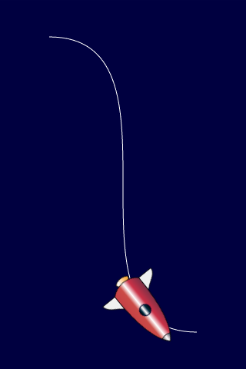
Path Animation
PathAnimation {
id: pathAnim
duration: 2000
easing.type: Easing.InOutQuad target: rocket
orientation: PathAnimation.RightFirst
anchorPoint: Qt.point(rocket.width/2, rocket.height/2) path: Path {
startX: rocket.width/2; startY: rocket.height/2 PathCubic {
x: window.width - rocket.width/2
y: window.height - rocket.height/2 control1X: x; control1Y: rocket.height/2
control2X: rocket.width/2; control2Y: y
}
} }
qml-animations/ex-animations/path-animation.qml

Slide 178
Animation Thread
Main thread
Animation may be frozen for a while when the UI is frozen
Animated property evaluated in each animation loop
Base QML type Animation
SceneGraph thread
Animation won’t be blocked even the UI thread is blocked
Animated property evaluated after the animation
Still painted in the UI thread
Use Animator sub-types just like Animation sub-types
ScaleAnimator, OpacityAnimator, RotationAnimator, XAnimator, YAnimator, UniformAnimator

Slide 179
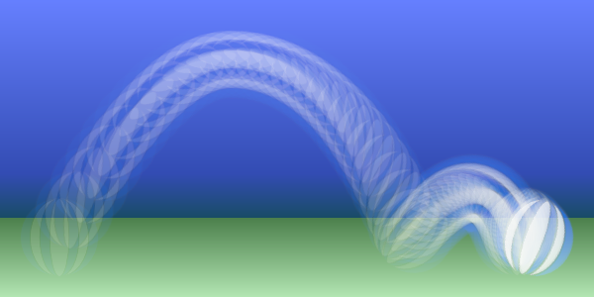
Lab: Bouncing Ball
Starting from the first partial solution:
Make the ball start from the ground and return to the ground.
Make the ball travel from left to right
Add rotation, so the ball completes just over one rotation
Reorganize the animations using sequential and parallel animations
Make the animation start when the ball is clicked
Add decoration (ground and sky)
qml-animations/lab-animations

Slide 180
Presenting Data

Slide 181
Contents
Arranging Items
Data Models
Using Views
XML Models
Views Revisited

Slide 182
Objectives
Can manipulate and present data:
Familiarity with positioners and repeaters
Rows, columns, grids, flows
Item indexes
Understanding of the relationship between models
Pure models
Visual models
XML models
Ability to define and use list models
Using pure models with repeaters and delegates
Using visual models with repeaters
Ability to use models with views
Using list and grid views
Decorating views
Defining delegates

Slide 183
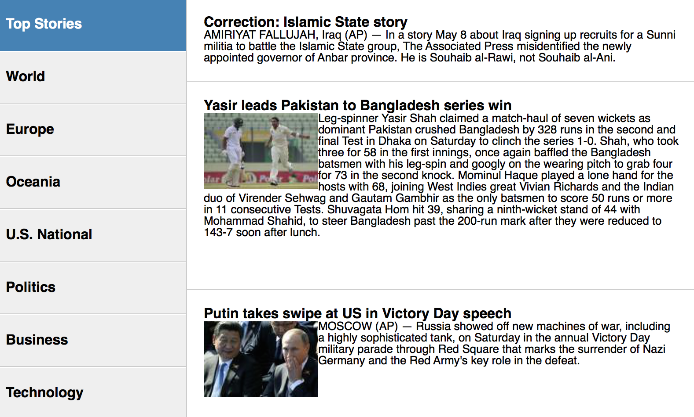
Why Use Model/view Separation?
Easily change the UI later
Add an alternative UI
Separation of concerns
Leads to easier maintenance
Easily change the data source
(XML? JSON? Other?)
Allows the use of 'dummy’ data during development
Many Qt APIs to consume the common data structures
Demo: <Qt Examples>/declarative/demos/rssnews/rssnews.pro

Slide 184
Arranging Items

Slide 185
Arranging Items
Positioners and repeaters make it easier to work with many items
Positioners arrange items in standard layouts
In a column: Column
In a row: Row
In a grid: Grid
Like words on a page: Flow
Repeaters create items from a template
For use with positioners
Using data from a model
Combining these make it easy to layout lots of items

Slide 186

Positioning Items
Grid {
x: 15; y: 15; width: 300; height: 300
columns: 2; rows: 2; spacing: 20
Rectangle { width: 125; height: 125; color: "red" }
Rectangle { width: 125; height: 125; color: "green" }
Rectangle { width: 125; height: 125; color: "silver" }
Rectangle { width: 125; height: 125; color: "blue" }
}
Items inside a positioner are automatically arranged
Ina 2 by 2 Grid
With horizontal/vertical spacing of 20 pixels
x, y is the position of the first item
Like layouts in Qt
qml-presenting-data/ex-arranging-items/grid-rectangles.qml

Slide 187
Repeating Items
Rectangle { width: 400; height: 400; color: "black" Grid { x: 5; y: 5 rows: 5; columns: 5; spacing: 10 Repeater {
model: 24
Rectangle { width: 70; height: 70 color: "lightgreen" }
}
}
}
The Repeater creates items
The Grid arranges them within its parent item
The outer Rectangle item provides
The space for generated items
A local coordinate system

Slide 188
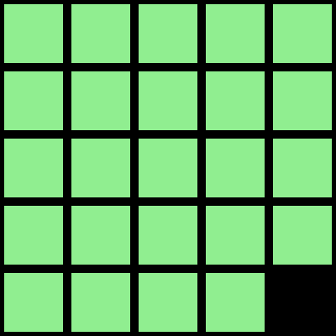
Repeating Items
Rectangle { width: 400; height: 400; color: "black" Grid { id: grid
x: 5; y: 5 rows: 5; columns: 5; spacing: 10 Repeater {
model: 24
Rectangle {
width: root.width / grid.columns – grid.spacing
height: root.height / grid.rows – grid.spacing
color: "lightgreen" }
}
}
}
Repeater takes data from a model
Just a number in this case
Creates items based on the template item
A light green rectangle
qml-presenting-data/ex-arranging-items/repeater-gird.qml

Slide 189
Indexing Items
Rectangle { width: 400; height: 400; color: "black" Grid { x: 5; y: 5 rows: 5; columns: 5; spacing: 10 Repeater {
model: 24
Rectangle {
width: …; height: …; color: "lightgreen" Text {
text: index
font.pointSize: 30
anchors.centerIn: parent }
}
}
}
}
Repeater provides an index for each item it creates
qml-presenting-data/ex-arranging-items/repeater-gird-index.qml

Slide 190
Positioner Hints and Tips
Anchors in the Row, Column or Grid
Apply to all the items they contain

Slide 191
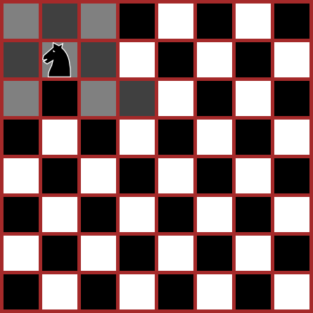
Lab – Chess Board
Start by creating a chess board using a Grid and a Repeater
Use the index to create a checker pattern
Use the knight.png image to create a piece that can be placed on any square
Bind its x and y properties to custom cx and cy properties
Make each square clickable
Move the piece when a suitable square is clicked
Make the model an Array that records which squares have been visited
Make the board and piece separate components
qml-presenting-data/lab-chess-boardl

Slide 192
Lab – Calendar
Start by creating a chess board using a Grid and a Repeater
Put the grid inside an Item
Use the index to give each square a number
Place a title above the grid
Ensure that the current date is highlighted
Use the left.png and right.png images to create buttons on each side of the title
Make the buttons navigate to the next and previous months
Add a header showing the days of the week
qml-presenting-data/lab-calendar

Slide 193
Data Models

Slide 194
Models and Views
Models and views provide a way to handle data sets
Models hold data or items
Views display data or items
Using delegates

Slide 195
Models
Pure models provide access to data:
ListModel
XmlListModel
Visual models provide information about how to display data:
Visual item model: ObjectModel
Contains child items that are supplied to views
Visual data model: DelegateModel
Contains an interface to an underlying model
Supplies a delegate for rendering
Supports delegate sharing between the views
Documentation: Data Models

Slide 196
List Models
List models contain simple sequences of list elements
Each ListElement contains
One or more pieces of data
Defined using properties
No information about how to display itself
ListElement does not have pre-defined properties
All properties are custom properties
ListModel {
id: nameModel
ListElement { … }
ListElement { … }
ListElement { … }
}

Slide 197
Defining a List Model
ListModel {
id: nameModel
ListElement { name: "Alice" }
ListElement { name: "Bob" }
ListElement { name: "Jane" }
ListElement { name: "Victor" }
ListElement { name: "Wendy" }
}
Define a ListModel
With an id so it can be referenced
Define ListElement child objects
Each with a name property
The property will be referenced by a delegate
qml-presenting-data/ex-models-views/list-model-list-view.qml

Slide 198
Manipulating a ListModel
ListModel is a dynamic list of items
Item type is defined by ListElement
Dynamic roles are supported as well (type is determined, when an item is added to the model)
Strongly discouraged
Using dynamic roles is 4-6 times slower than using static ones
Use for example QVariantMap instead
Items can be appended, inserted, removed and moved – also in another thread
append item data using JavaScript dictionaries:
bookmarkModel.append({"title": lineEdit.text})
remove items by index obtained from a ListView:
bookmarkModel.remove(listView.currentIndex)
move a number of items between two indices:
bookmarkModel.move(listView.currentIndex, listView.currentIndex + 1, number)

Slide 199
Defining a Delegate
Component {
id: nameDelegate
Text {
text: name;
font.pixelSize: 32
}
}
Define a Component to use as a delegate
With an id so it can be referenced
Describes how the data will be displayed
Properties of list elements can be referenced
Use a Text item for each list element
Use the value of the name property from each list element

Slide 200
Delegates, Contexts, and Attached Properties
Each property is exposed in one context
Defines how the property can be accessed together with the scope rules
Views, Repeater, Instantiator, expose properties to delegate instances in sub-contexts
This allows the parent to expose properties, visible in the sub-context only (index, modelData)
modelData is exposed, if the model is a string or object list
Views also provide attached properties to delegates
Component {
id: nameDelegate
Text {
property var listView: ListView.view
text: name; font.pixelSize: 32
color: (listView.currentIndex === index) ? "red" : "black"
}
}

Slide 201
Using a List Model
Column {
anchors.fill: parent
Repeater {
model: nameModel
delegate: nameDelegate
} }
A Repeater fetches elements from nameModel
Using the delegate to display model elements as Text items
A Column arranges them vertically
Using anchors to make room for the items

Slide 202
Working with Items
ListModel is a dynamic list of items
Items can be appended, inserted, removed and moved
Append item data using JavaScript dictionaries:
bookmarkModel.append({"title": lineEdit.text})
Remove items by index obtained from a ListView
bookmarkModel.remove(listView.currentIndex)
Move a number of items between two indices:
bookmarkModel.move(listView.currentIndex, listView.currentIndex + 1, number)
Roles (item types) may be dynamic – dynamicRoles property set to true
Strongly discouraged
Using dynamic roles is 4-6 times slower than using static ones
Use for example QVariantMap instead

Slide 203
List Model Hints
Note: Model properties cannot shadow delegate properties:
ListModel {
ListElement { text: "Alice" }
}
Component {
Text {
text: text; // Will not work
}
}

Slide 204
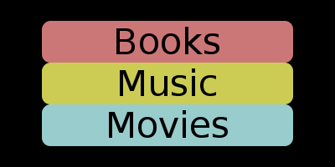
Defining an Object Model
Rectangle {
width: 400; height: 200; color: "black" ObjectModel {
id: labels
Rectangle { color: "#cc7777"; radius: 10.0
width: 300; height: 50
Text { anchors.fill: parent
font.pointSize: 32; text: "Books"
horizontalAlignment: Qt.AlignHCenter } }
Rectangle { color: "#cccc55"; radius: 10.0
width: 300; height: 50
Text { anchors.fill: parent
font.pointSize: 32; text: "Music"
horizontalAlignment: Qt.AlignHCenter } }
} }
Define a ObjectModel item
With an id so it can be referenced
Import QtQml.Models

Slide 205
Defining an Object Model
Rectangle {
width: 400; height: 200; color: "black" ObjectModel {
id: labels
Rectangle { color: "#cc7777"; radius: 10.0
width: 300; height: 50
Text { anchors.fill: parent
font.pointSize: 32; text: "Books"
horizontalAlignment: Qt.AlignHCenter } }
Rectangle { color: "#cccc55"; radius: 10.0
width: 300; height: 50
Text { anchors.fill: parent
font.pointSize: 32; text: "Music"
horizontalAlignment: Qt.AlignHCenter } }
} }
Define child items
These will be shown when required

Slide 206
Using an Object Model
Rectangle {
width: 400; height: 200; color: "black" ObjectModel {
id: labels
….
} Column {
anchors.horizontalCenter: parent.horizontalCenter
anchors.verticalCenter: parent.verticalCenter
Repeater { model: labels }
}
}
A Repeater fetches items from the labels model
A Column arranges them vertically

Slide 207
Hierarchical Models
QML models have named properties , used by views
Hierarchical C++ models can be used with DelegateModel from QtQml.Models
Provides access to QAbstractItemModel model index (rootIndex) also persistent ones
Provides navigation functions to access child items and parent items in the model hierarchy
Navigate down - modelIndex()
Navigate up - parentModelIndex()

Slide 208
Hierarchical Models
ListView {
anchors.fill: parent model: DelegateModel {
model: delegateModel delegate: Item {
property var view: ListView.view
width: childrenRect.width
height: childrenRect.height
MouseArea {
anchors.fill: parent
acceptedButtons: Qt.RightButton | Qt.LeftButton
onClicked: {
if (mouse.button === Qt.LeftButton) {
if (model.hasModelChildren) {
++level;
view.model.rootIndex =
view.model.modelIndex(index);
qml-presenting-data/ex-models-views/hierarchical-model/hierarchical-model.pro

Slide 209
Presenting Data

Slide 210
Views
ListView shows a classic list of items
With horizontal or vertical placing of items
GridView displays items in a grid
Like an file manager's icon view

Slide 211
List Views
Take the model and delegate from before:
ListModel {
id: nameModel
ListElement { name: "Alice" }
ListElement { name: "Bob" }
ListElement { name: "Jane" }
ListElement { name: "Victor" }
ListElement { name: "Wendy" }
}
Component {
id: nameDelegate
Text {
text: name;
font.pixelSize: 32
}
}

Slide 212
List Views
ListView {
anchors.fill: parent
model: nameModel
delegate: nameDelegate
clip: true }
No default delegate
Unclipped views paint outside their areas
Set the clip property to enable clipping
Views are positioned like other items
The above view fills its parent
qml-presenting-data/ex-models-views/list-model-list-view.qml

Slide 213
Decoration and Navigation
By default, ListView is
Undecorated
A flickable surface (can be dragged and flicked)
To add decoration:
With a header and footer
With a highlight item to show the current item
To configure for navigation:
Set focus to allow keyboard navigation
Property highlight also helps the user with navigation
Unset interactive to disable dragging and flicking
qml-presenting-data/ex-models-views/list-view-decoration.qml

Slide 214
Decoration and Navigation
ListView {
anchors.fill: parent
model: nameModel
delegate: nameDelegate
focus: true
clip: true
header: Rectangle {
width: parent.width; height: 10;
color: "pink” }
footer: Rectangle {
width: parent.width; height: 10;
color: "lightblue" }
highlight: Rectangle {
width: parent.width
color: "lightgray" } }

Slide 215
Decoration and Navigation
Each ListView exposes its current item:
Recall that, in this case, each item has a text property
re-use the listView's currentItem's text
ListView {
id: listView
} Text {
id: label
anchors.bottom: parent.bottom
anchors.horizontalCenter: parent.horizontalCenter
text: "<b>" + listView.currentItem.text + "</b> is current"
font.pixelSize: 16
}
qml-presenting-data/ex-models-views/list-view-current.item.qml

Slide 216
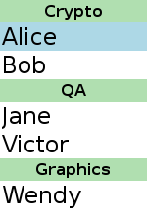
Adding Sections
Data in a ListView can be ordered by section
Categorize the list items by
Choosing a property name; e.g. team
Adding this property to each ListElement
Storing the section in this property
ListModel {
id: nameModel
ListElement { name: "Alice"; team: "Crypto" }
ListElement { name: "Bob"; team: "Crypto" }
ListElement { name: "Jane"; team: "QA" }
ListElement { name: "Victor"; team: "QA" }
ListElement { name: "Wendy"; team: "Graphics" }
}

Slide 217
Displaying Sections
Using the ListView
Set section.property
Refer to the ListElement property holding the section name
Set section.criteria to control what to show
ViewSection.FullString for complete section name
ViewSection.FirstCharacter for alphabetical groupings
Set section.delegate
Create a delegate for section headings
Either include it inline or reference it

Slide 218
Displaying Sections
ListView {
model: nameModel
section.property: "team”
section.criteria: ViewSection.FullString
section.delegate: Rectangle {
color: "#b0dfb0"
width: parent.width
height: childrenRect.height + 4
Text { anchors.horizontalCenter: parent.horizontalCenter
font.pixelSize: 16
font.bold: true
text: section }
} }
The section.delegate is defined like the highlight delegate

Slide 219
Grid Views
Set up a list model with items:
Define string properties to use in the delegate
ListModel {
id: nameModel
ListElement { file: "../images/rocket.svg" name: "rocket" }
ListElement { file: "../images/clear.svg" name: "clear" }
ListElement { file: "../images/arrow.svg" name: "arrow" }
ListElement { file: "../images/book.svg" name: "book" }
}
ml-presenting-data/ex-models-views/list-model-grid-view.qml

Slide 220
Grid Views
Set up a delegate:
Component {
id: nameDelegate
Column {
Image {
id: delegateImage
anchors.horizontalCenter: delegateText.horizontalCenter
source: file; width: 64; height: 64; smooth: true
fillMode: Image.PreserveAspectFit
}
Text {
id: delegateText
text: name; font.pixelSize: 24
}
}
}

Slide 221
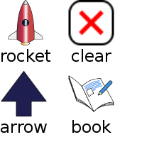
Grid Views
GridView {
anchors.fill: parent
model: nameModel
delegate: nameDelegate
clip: true
}
The same as ListView to set up
Uses data from a list model
Not like Qt's table view
More like Qt's list view in icon mode

Slide 222
Decoration and Navigation
Like ListView, GridView is
Undecorated and a flickable surface
To add decoration:
Define header and footer
Define highlight item to show the current item
To configure for navigation:
Set focus to allow keyboard navigation
Highlight also helps the user with navigation
Unset interactive to disable dragging and flicking
qml-presenting-data/ex-models-views/grid-view-decoration.qml

Slide 223
Decoration and Navigation
GridView {
…
header: Rectangle {
width: parent.width; height: 10
color: "pink"
}
footer: Rectangle {
width: parent.width; height: 10
color: "lightblue"
}
highlight: Rectangle {
width: parent.width
color: "lightgray"
}
focus: true clip: true
}

Slide 224
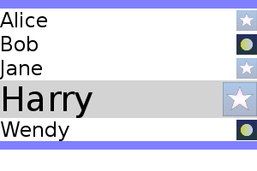
Lab – Contacts
Create a ListItemModel, fill it with ListElement objects, each with
A name property
A file property referring to an image
Add a ListView and a Component to use as a delegate
Add header, footer and highlight properties to the view
Add states and transitions to the delegate
Activate the state when the delegate item is current
Use a state condition with the ListView.isCurrentItem attached property
Make a transition that animates the height of the item

Slide 225
XML Models

Slide 226
XML List Models
Many data sources provide data in XML formats
QML type XmlListModel is used to supply XML data to views
Using a mechanism that maps data to properties
Using XPath queries
Views and delegates do not need to know about XML
Use a ListView or Repeater to access data

Slide 227
Defining an XML List Model
XmlListModel {
id: xmlModel
source: "files/items.xml"
query: "//item" XmlRole { name: "title"; query: "string()" }
XmlRole { name: "link"; query: "@link/string()" } } }
Set the id property so the model can be referenced
Specify the source of the XML
The query identifies pieces of data in the model
Each piece of data is queried by XmlRole instances
qml-presenting-data/ex-models-views/xml-list-model.qml

Slide 228
XML Roles
QML type XmlRole associates names with data obtained using XPath queries
Made available to delegates as properties
Properties title and link in the above example

Slide 229
Using an XML List Model
TitleDelegate {
id: xmlDelegate
} ListView {
anchors.fill: parent
anchors.margins: 4
model: xmlModel
delegate: xmlDelegate }
Specify the model and delegate as usual
Ensure that the view is positioned and given a size
QML type TitleDelegate is defined in TitleDelegate.qml
Must be defined using a Component type
qml-presenting-data/ex-models-views/TitleDelegate.qml

Slide 230
Defining a Delegate
Component {
Item {
width: parent.width; height: 64 Rectangle {
width: Math.max(childrenRect.width + 16, parent.width)
height: 60; clip: true
color: "#505060"; border.color: "#8080b0"; radius: 8 Column {
Text { x: 6; color: "white"
font.pixelSize: 32; text: title }
Text { x: 6; color: "white"
font.pixelSize: 16; text: link }
}
}
}
}
Property parent refers to the view where it is used
Properties title and link are properties exported by the model

Slide 231
Views Revisited

Slide 232
Customizing Views
All views are based on the Flickable item
Children will be parented to contentItem property
Define the flicking behavior or disable it completely with interactive: false
flickDirection, flickDeceleration, horizontalVelocity, verticalVelocity, boundsBehavior(StopAtBounds, DragOverBounds), pixelAligned, rebound, …
Key navigation of the highlighted item does not wrap around
Set keyNavigationWraps to true to change this behavior
The highlight can be constrained
Set the highlightRangeMode property
Value ListView.ApplyRange tries to keep the highlight in a given area
Value ListView.StrictlyEnforceRange keeps the highlight stationary, moves the items around it

Slide 233
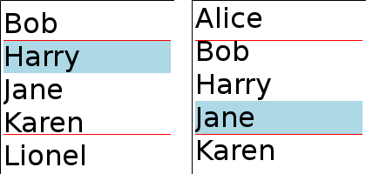
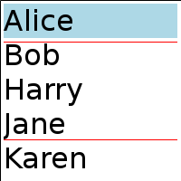
Customizing Views
ListView {
preferredHighlightBegin: 42
preferredHighlightEnd: 150
highlightRangeMode: ListView.ApplyRange
…
}
View tries to keep the highlight within range
Highlight may leave the range to cover end items
Properties preferredHighlightBegin and preferredHighlightEnd should
Hold coordinates within the view
Differ by the height/width of an item or more
qml-presenting-data/ex-models-views/list-view-highlight-range-apply.qml

Slide 234
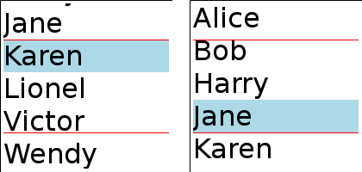
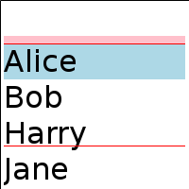
Customizing Views
ListView {
preferredHighlightBegin: 42
preferredHighlightEnd: 150
highlightRangeMode:
ListView.StrictlyEnforceRange
…
}
View always keeps the highlight within range
View may scroll past its end to keep the highlight in range
Properties preferredHighlightBegin and preferredHighlightEnd should
Hold coordinates within the view
Differ by the height/width of an item or more
qml-presenting-data/ex-models-views/list-view-highlight-range-strict.qml

Slide 235
Optimizing Views
Views create delegates to display data
Delegates are only created when they are needed
Delegates are destroyed when no longer visible
This can impact performance
Delegates can be cached to improve performance
Property cacheBuffer is the maximum number of delegates to keep (calculated as a multiply of the height of the delegate)
Trades memory usage for performance
Useful if it is expensive to create delegates; for example
When obtaining data over a network
When delegates require complex rendering
Avoid heavy and complicated delegates
Heavy part of the delegate can be loaded on demand using Loader

Slide 236
Qt Quick Controls

Slide 237
Contents
Qt Quick Designer
Qt Quick Controls
Application Window
Controls and Views
Localization
Layouts
Styling

Slide 238
Objectives
Qt Quick Designer
UI design and layout
Forms and components
Essential controls
Application window
Controls
Containers
Views
Layouts
How to create expandable controls
Differences between anchors, positioners and QtQuick Layouts
Styles
Learn how to style controls

Slide 239
Qt Quick Designer
Allows composing UIs from QML types, Qt Quick Controls, and custom types
Allows defining UI layout, creating properties and property bindings
Clear separation between UI and business logic
UI designed in form files with ui.qml extension – do not use JavaScript code in forms
Business logic implemented in .qml and .cpp files
Qt Quick Designer creates empty signal handlers in component files for selected signals

Slide 240
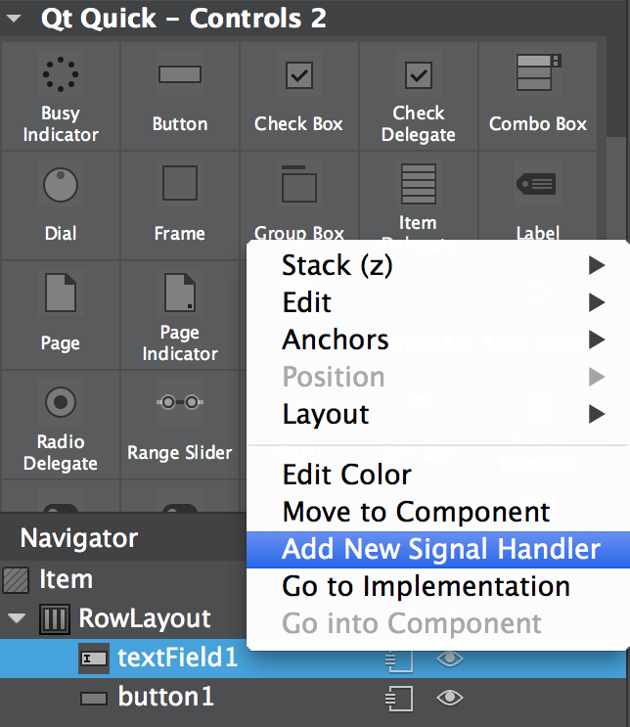
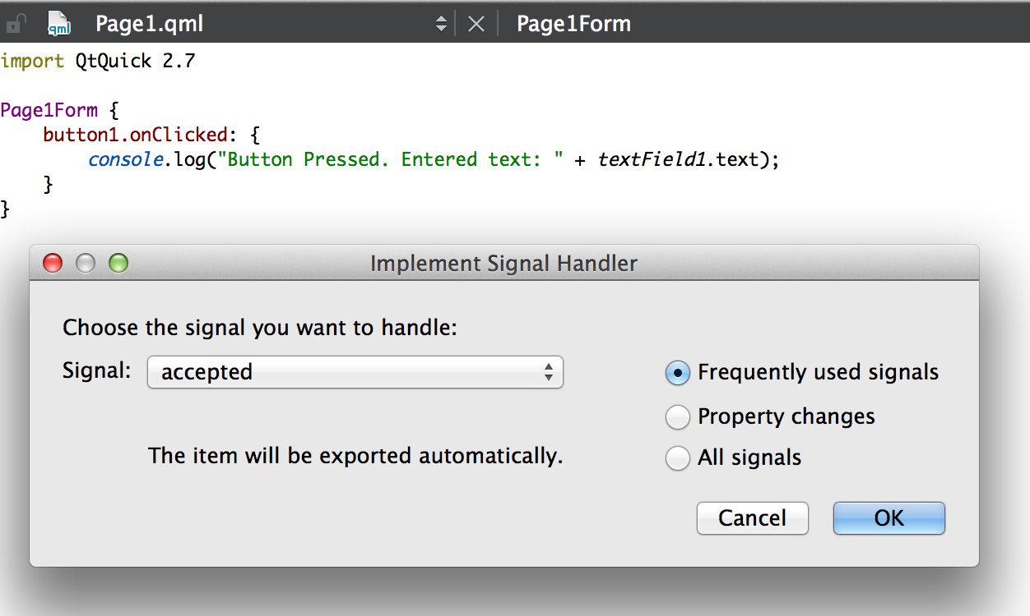
Separation between the UI and Business Logic
Drag and drop UI controls and specify their layout
Add signal handlers into the component file – not in the form

Slide 241
Qt Quick Controls
Ready-made UI control QML types
Two versions
Prefer using Qt Quick Controls 2
Some controls are only available in Qt Quick Controls 1 (TablewView, TreeView)
Qt Quick Controls 1 extend existing QML types (Button -> FocusScope)
Not optimal for memory consumption or performance point of view
Button: 15 QQuickItems (including 4 Loaders), totally 60 QObjects
Button in Qt Quick Controls 2: 4 QQuickItems, 7 QObjects, 7 times faster to create
Biggest differences in event handling and styling
Qt Quick Controls 2 event handling in C++
Qt Quick Controls styled with control-specific style types
Qt Quick Controls 2 styled with application-global, configurable style

Slide 242
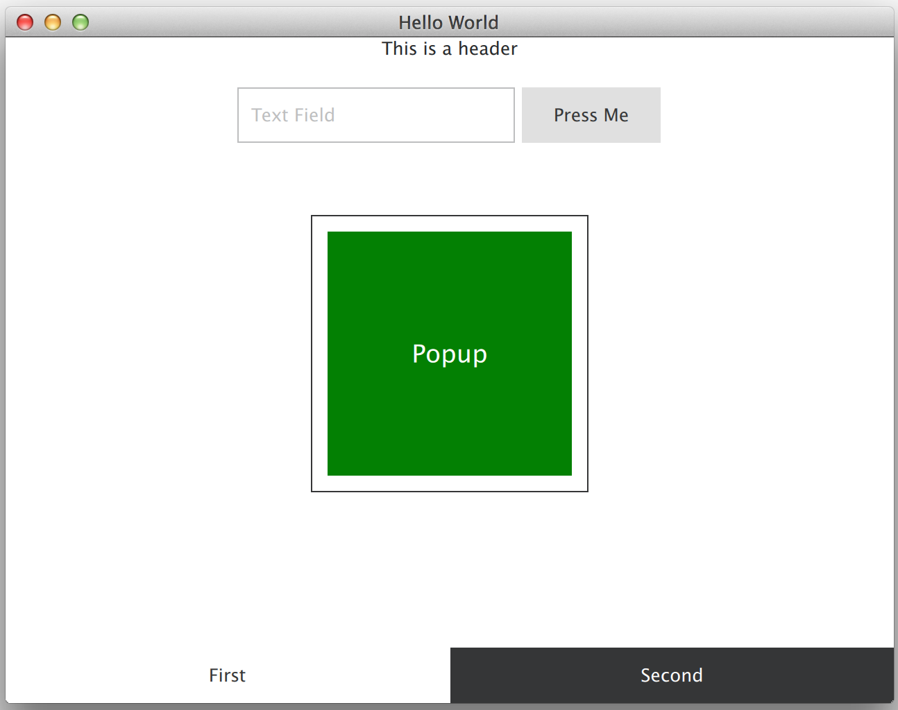
Qt Quick Controls
More than just UI controls
ApplicationWindow
Views
Ready-made layout and/or navigation
Scroll, stack, and swipe views
Split, tab, and table views only in Qt Quick Controls 1
Layouts
Can dynamically shrink/expand items in the layout
Controls
Button, BusyIndicator, ComboBox, Drawer, Page, Pane, ScrollBar, Slider, SpinBox, Tumbler, RangeSlider, DelayButton

Slide 243
Application Window

Slide 244
Application Window
Window QML type instantiates QQuickWindow C++ class
Basic window management: geometry, visibility, window flags, background color
Syncs with scene graph to render items on the scene
Multiple screen support
Qt supports multiple screens
Easy to define with which screen the window is associated with – use property screen
Useful Screen properties: screen orientation, screen physical dimensions and pixels, pixel density
ApplicationWindow extends Window
property int orientation: Screen.orientation Screen.orientationUpdateMask: Qt.PortraitOrientation
// The default mask value is 0

Slide 245
Application Window
Header and footer items
Menubar
With menus, sub-menus, separators, and actions
Content
Window children
For example, a view, a container, a control, an item
Background
Any item
Overlay
Modal or non-modal popup
Modal popup dims the window
Window-specific palette
qml-controls/ex-application-window.qml

Slide 246
Application Window
ApplicationWindow {
visible: true; width: 640; height: 480; title: qsTr("Hello World") header: Label {
horizontalAlignment: Qt.AlignHCenter
text: qsTr("This is a header") }
footer: TabBar {
TabButton { text: qsTr("Open a popup 1")
onClicked: popup.open();
}
}
Popup { id: popup
width: parent.width * 0.5; height: parent.height * 0.5
x: (parent.width - width) / 2; y: (parent.height - height) / 2
modal: true
Text { anchors.centerIn: parent text: qsTr("Text in popup") }
}
Container { id: container }
qml-controls/ex-application-window

Slide 247
Controls and Views

Slide 248
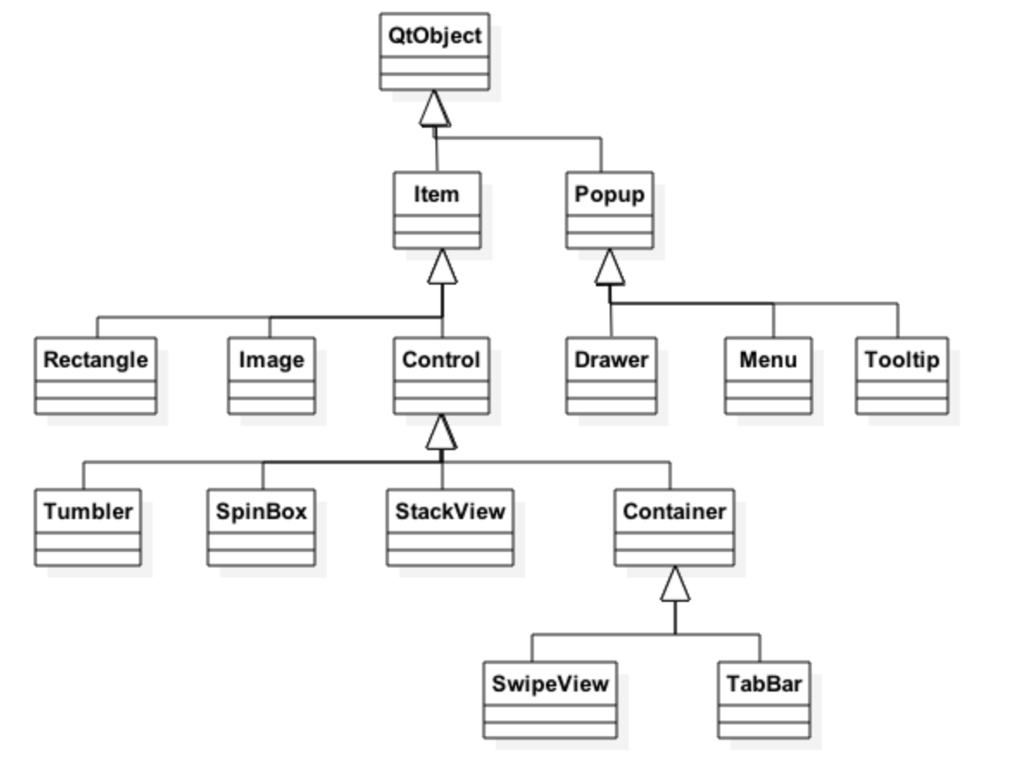
Controls and Views

Slide 249
Controls
Extend Control
Generic content – property contentItem
Event handling
Interactive controls do not pass mouse click and touch events to the item below them
Locale aware
Background
Layout
Control’s implicit size is the background’s implicit size by default
Palette
Focus
Any item may request to get active focus (property focus)

Slide 250
Palette
Basic QML type palette
Defines color of various roles
Application wide
Maintained by the application window
Can be set in QGuiApplication
Propagated to all window children
Can be customized in controls
All control children will use the customized palette
Some color properties
palette.base
palette.brightText
palette.text
ApplicationWindow {
id: window visible
// All child controls will have blue foreground text
palette.text: "blue"

Slide 251
Localization
Unicode support for strings
On-screen user visible texts
Can be marked localizable
Plural handling (1 file vs 2 files)
Retranslation support
QQmlEngine::retranslate()
Locale awareness
Number and date formats
Locale-based resources (icon_de_DE.png)
Translation tool - Qt Linguist
LTR and RTL text, positioners, list and grid views

Slide 252
Localized Strings
lupdate - scans C++ and .ui files for strings and creates or updates the translation script .ts file
Uses SOURCES and FORMS in .pro file
Must add QML files into SOURCES
lupdate_only {
SOURCES += *.qml }
linguist – graphical tool to localize strings
lrelease - reads .ts files and creates .qm binary files
QTranslator – allows adding any number of translations
Call retranslate() after a new language has been added – refreshes ALL bindings

Slide 253
String Localization in QML
Strings are localized with translation functions
string qsTr(string sourceTest, string disambiguation, int n)
string qsTranslate(string context, string sourceTest, string disambiguation, int n)
string qsTrId(string id)
//% “I’m a template %n” // Possible to define templates
property string localizedText: qsTrId(“someId”, 7);
String ids require lrelease –idbased option
Note! Functions do not work in .js files
Context and comments may be used to help the translator
// : Comment
//~Context The text is used in 3D graphics programming
If the same text must be used in different ways, disambiguation can be used
Otherwise, the same single translation used everywhere, where the same sourceText used

Slide 254
String Localization in QML
To localize string arrays, use QT_TR_NOOP(), QT_TRANSLATE_NOOP() or QT_TRID_NOOP() functions
They Identify a string, requiring translation, but uses qs*() functions to do the actual translation
All the strings can be managed in one place
var stringArray[] = [ QT_TR_NOOP(“hello”), QT_TR_NOOP(“world”) ]
Text { text: qsTr(stringArray(0)) }
Translation functions look for translations from all installed translation modules, starting from the last one installed
The first translation found (if any), will be returned
Otherwise, the sourceText is returned
QQmlApplicationEngine tries to find and install a system default translation automatically
If provided in qml folder adjacent to main.qml file and named as qml_language_country.qm (e.g., qml_fi_FI.qm)

Slide 255
LTR and RTL Support
Text, TextInput, and TextEdit automatically align the text according to QInputMethod::inputDirection(), which uses the system locale
Can be overridden with horizontalAligment property or LayoutMirroring.enabled attached property
The latter changes the effective layout direction
Text {
text: "خامل"
horizontalAlignment: Text.AlignLeft
LayoutMirroring.enabled: true
}
Row, Grid, Flow, ListView, GridView
By default horizontal direction is left to right
Change using layoutDirection property (Qt.RightToLeft) or LayoutMirroring

Slide 256
LTR and RTL Support
LayoutMirroring can be used to mirror left and right anchors
Again actual anchors do not change, but the effective layout direction changes
LayoutMirroring does not inherit to child items by default
Use LayoutMirroring.childrenInherit to change this
Current layout direction may be queried with
Qt.application.layoutDirection property
And changed with QGuiApplication::setLayoutDirection()
It’s also possible to make the layout direction locale aware by defining
QT_TRANSLATE_NOOP("QGuiApplication", "QT_LAYOUT_DIRECTION");
And defining RTL or LTR as a “translation”

Slide 257
Locale-Aware Applications
Locale makes your applications locale-aware
Supports converting numbers to strings with different locale formatting
Possible to get the system locale and set the default locale
var fin = Qt.locale(“fi_FI”);
Number formats
Use %L1 to format a parameter according to the current locale
qsTr(“%L1 “).arg(someNumber);
Date and time format
qsTr(“Today is %1”).arg(Date().toLocaleString(Qt.locale()));
Currencies
var hugeAmountOfMoney = 12.97;
var moneyString = hugeAmountOfMoney.toLocaleCurrencyString(fin, Locale.currencySymbol(Locale.CurrencySymbol)); // CurrencyIsoCode, CurrencyDisplayName

Slide 258


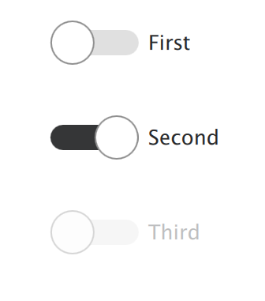
Controls
Button
Can be clicked or touched
Properties: action with shortcuts, autoExclusive, display (icon, text or both)
Multi-touch support, like in Slider
Slider
Used to select a value by sliding a handle
Properties: from, to, position, value, handle, snapMode
Live value update (default), like in RangeSlider and Dial
ComboBox
Combined button and popup list for selection options
Can be editable
qml-controls/ex-controls

Slide 259
Container Control
Control, which supports adding, inserting, moving, and removing items
Additional properties: currentIndex and currentItem
No visual presentation
Defined by the contentItem property
Container items are defined using contentModel default property
All children are assigned to the contentModel default property
Page is another container (not Container sub-type) having a header and a footer
Container {
id: container
contentItem: ListView {
model: container.contentModel
}
Image { source: ”qrc:/images/page1_image” }
Image { source: ”qrc:/images/page2_image” }
qml-controls/ex-container

Slide 260
Adding Items Dynamically
footer: TabBar { id: tabBar
currentIndex: container.currentIndex
TabButton {
text: qsTr("+")
onClicked: tabBar.addItem(tabButton.createObject(tabBar));
}
Component {
id: tabButton
TabButton {
text: qsTr("I'm removed by clicking")
onClicked: tabBar.removeItem(tabBar.currentIndex);
}
}
}
qml-controls/ex-dynamic-tab-bar

Slide 261
Views – StackView
Allows user to push, pop, and replace pages in the stack
Only the top-most item visible
Several pages may be pushed in one function call, only the topmost created
Custom animations may be defined for view transitions
StackView {
id: stackView
initialItem: page pushEnter: Transition {
ParallelAnimation {
RotationAnimation { from: 0; to: 360 }
NumberAnimation { properties: "opacity”; from: 0.0; to: 1.0;
easing.type: Easing.InOutQuad }
}
} Component {
id: page
qml-controls/ex-views/ex-stackview

Slide 262
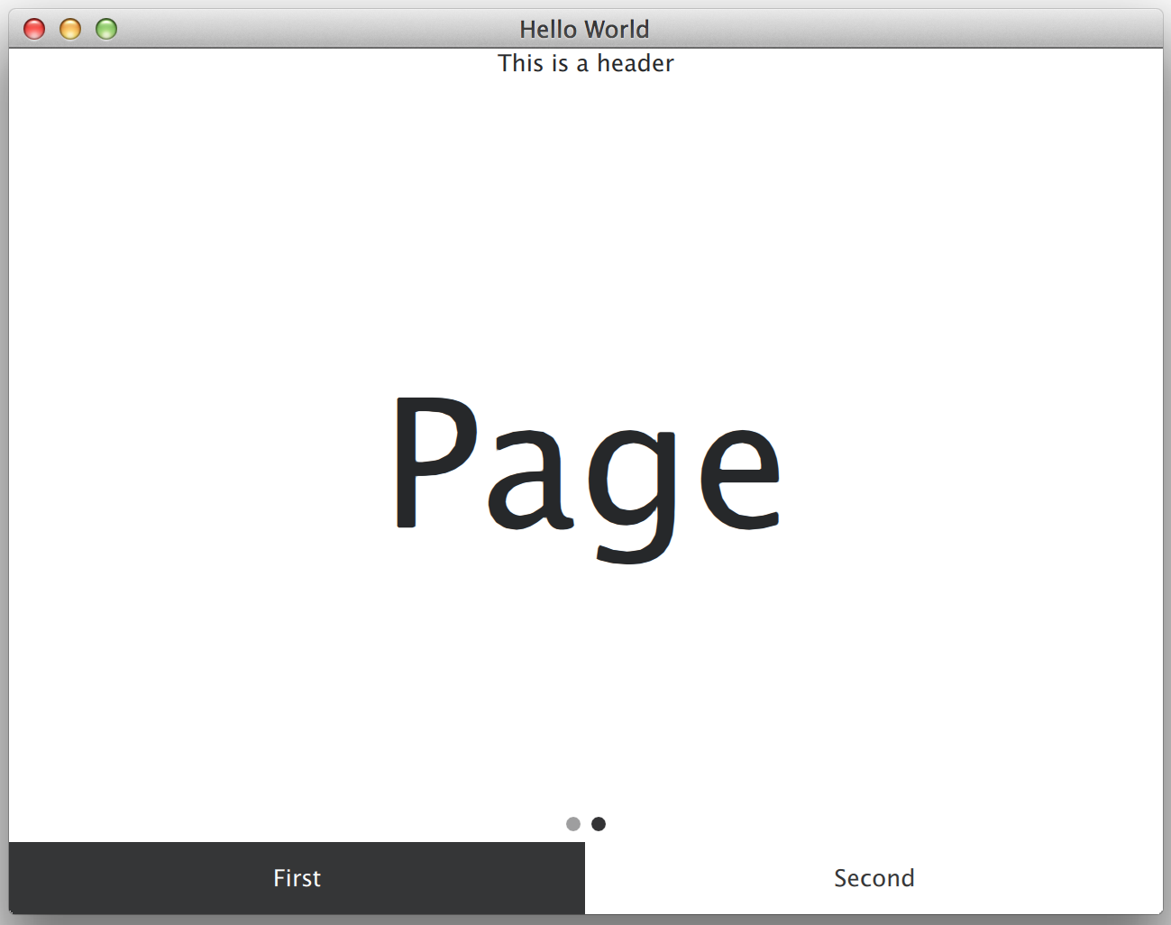
Views – SwipeView
Swipe trigged page navigation
Pages may be dynamically added and removed
As extends Container
Page indicator helps user to see there are multiple pages
Another control added by the developer
SwipeView {
id: swipeView; anchors.fill: parent
currentIndex: tabBar.currentIndex Page { Label { text: qsTr(”Page"); anchors.centerIn: parent } } } PageIndicator { id: indicator count: swipeView.count; currentIndex: swipeView.currentIndex anchors.bottom: swipeView.bottom;
anchors.horizontalCenter: parent.horizontalCenter
}
}
qml-controls/ex-views/ex-swipeview

Slide 263
Qt Quick Controls 1 Views
Split view
Lays out items horizontally or vertically using draggable splitters
Compare to widget’s QSizePolicy::Expanding
Tab view
Allows user to select one of the stacked items
For example, Settings application
Scroll view
Used to replace Flickable or decorate Flickable
Three item properties: contentItem, viewport, flikacbleItem
Sub-items TableView, TextArea
TableView

Slide 264
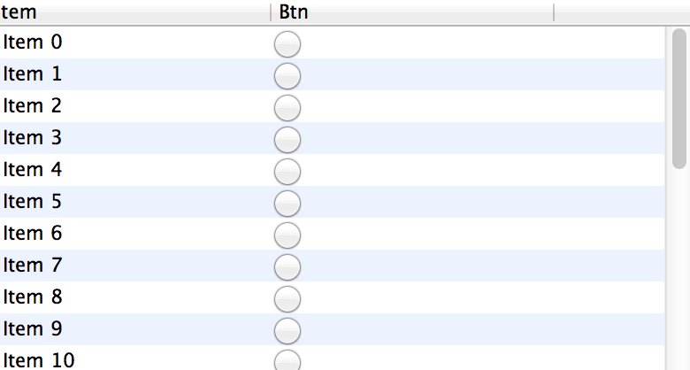
TableView
TableView {
TableViewColumn {
title: "Btn"
role: "btnChecked"
delegate: tableViewDelegate }
model: simpleModel } Component {
id: tableViewDelegate
Item {
RadioButton {
checked: (styleData.value === "false") ? false : true } } } ListModel { id: simpleModel }
Provides scroll bars as inherits from ScrollArea
Item, row, and column delegates
Different delegates are exposed different data using the styleData property
Based on ListView
No item index selections, for example
qml-controls/ex-views/ex-tableview

Slide 265
Layouts

Slide 266
Layouts
Default behavior is similar to positioners
However, can be used in the same way as QLayout works for widgets
The layout automatically defines the size of the items – no anchors or explicit width/height needed
Just set the Layout.fillHeight or Layout.fillWidth to
false – if you do not want the layout to use all extra space for the item
true – if you want the extra space to be used to expand the item
Compare to QSizePolicy::Expanding

Slide 267

Layouts Example
GridLayout {
columns: 3
…
Button {
text: qsTr("Btn 2")
Layout.fillHeight: true
… }
Button {
text: qsTr("Btn 4")
Layout.fillWidth: true
… }
Two buttons expand vertically and horizontally
Other button dimensions are based on the text and font properties
qml-controls/ex-views/ex-layouts

Slide 268
Styling

Slide 269

Styling
Cross-platform icon themes
Stylable control properties
background
contentItem
Qt Quick templates
Stylable control-specific properties
Configuration file
Define, which style and which style-specific property values used

Slide 270
Icon Themes
Buttons, item delegates, and menu items support icons
Default icon size and color defined in a style
Can be overridden with icon properties
icon.name: “File-open”; icon.source: “open.png”
Icon themes allow using the same icons everywhere in the application
Set the theme name before loading the QML file
QIcon::setThemeName("clusterTheme");
[Icon Theme]
Name=clusterTheme
Comment=Cluester Icon Theme Directories=32x32,32x32@2 [32x32]
Size=32
Type=Fixed [32x32@2]
Size=32
<RCC>
<qresource prefix="/">
<file>icons/desktopTheme/index.theme</file>
<file>icons/desktopTheme/32x32/open.png</file>
<file>icons/desktopTheme/32x32@2/open.png</file>
</qresource>
</RCC>

Slide 271
Qt Quick Templates
Non-visual implementation of control’s logic and behavior
Style agnostic
Style properties defined in $QTDIR/qml/QtQuick/Controls.2/ControlType.qml
Implicit dimension, padding, spacing, icon properties, contentItem, background
To create a custom style
Create a style folder
Copy controls, you want to style, from $QTDIR/qml/QtQuick/Controls.2
Apply existing style property values, if applicable
Implement customizations
Apply the style using the configuration file, a command line switch –style, an environment variable or set with QQuickStyle::setStyle(“CustomStyle”)
qml-controls/ex-views/ex-styles

Slide 272
Custom Style Property
Declare a QObject subclass with
a style property Q_PROPERTY(int styleProperty…)
a factory: static CoolStyle *qmlAttachedProperties(QObject *object);
QML_DECLARE_TYPEINFO(CoolStyle, QML_HAS_ATTACHED_PROPERTIES)
Register your C++ type for the QML engine
qmlRegisterUncreatableType<CoolStyle>(“StyleModule”, 42, 0, “CoolStyleName”, “Error message”)
Use the property in custom styling
import StyleModule 42.0
Button {
text: "Button 2”
CoolStyleName.styleProperty: 23 }

Slide 273

Qt Quick Controls Styles
Define attached properties, used in controls styling
Default style
Light-weight default style
Used as a fallback, if the style does not implement a control
Imaging style
Property path defines the image assets location
Material and Universal styles
Google Material and MS Universal Design Guidelines –based styles
Properties: accent, background, foreground, theme, primary (only in Material style)
Fusion style
Platform-agnostic style, providing desktop look’n’feel
import QtQuick.Controls.Material 2.0 Button {
text: "Stop”; highlighted: true Material.accent: Material.Red
Material.theme: Material.Dark
}

Slide 274
Configuration File
Deployed in resources similarly to QML files
Configure style and style properties
Configure default font properties
Configure palette
[Controls]
Style=Custom
[Universal]
Theme=Dark
Font\Family=Courier New
Font\PointSize=24
Font\Style=StyleItalic
[Custom]
Palette\Text=#abcdef

Slide 275
Platform, Locale, and Style Variants
Built-in support for selecting different variants of QML files
Based on the file selectors
Platform
:/CustomControl.qml
:/+linux/CustomControl.qml
Locale
:/+fi_FI/CustomControl.qml
Style
:/+custom/CustomControl.qml
Variants may be combined as well
:/+custom/+fi_FI/CustomControl.qml

Slide 276
Summary
Qt Quick Controls provide ready-made UI controls
ApplicationWindow provides a QQuickWindow with header and footer
Window may contain any views, controls, items
Split view, stack view, tab view, scroll view
Button, slider, label etc.
Controls may be styled in three ways
With custom background and content items
By changing existing style properties
By creating completely new styles

Slide 277
C++ Integration

Slide 278
Objectives
The QML runtime environment
Understanding of the basic architecture
Ability to set up QML in a C++ application
Exposing C++ objects to QML
Knowledge of the Qt features that can be exposed
Familiarity with the mechanisms used to expose objects
qml-cpp-integration/ex-clock

Slide 279
Declarative Environment

Slide 280
Overview
Qt Quick is a combination of technologies:
A set of components, some graphical
A declarative language: QML
Based on JavaScript
Running on a virtual machine
A C++ API for managing and interacting with components
The QtQuick module

Slide 281
Setting up a QtQuick Application
#include <QGuiApplication>
#include <QQmlApplicationEngine>
int main(int argc, char *argv[])
{
QGuiApplication app(argc, argv);
QQmlApplicationEngine engine;
engine.load(QUrl(QStringLiteral("qrc:/animation.qml")));
return app.exec();
}
qml-cpp-integration/ex-simpleviewer

Slide 282
Setting up QtQuick
QT += quick
RESOURCES = simpleviewer.qrc
SOURCES = main.cpp
import QtQuick 2.5
import QtQuick.Window 2.2
Window {
visible: true
width: 400; height: 300
qml-cpp-integration/ex-simpleviewer

Slide 283
Exporting C++ Objects to QML

Slide 284
Exporting C++ Objects to QML
C++ objects can be exported to QML
The notify signal is needed for correct property bindings!
Q_PROPERTY must be at top of class
class User : public QObject {
Q_OBJECT
Q_PROPERTY(QString name READ name WRITE setName NOTIFY nameChanged)
Q_PROPERTY(int age READ age WRITE setAge NOTIFY ageChanged)
public:
User(const QString &name, int age, QObject *parent = 0); ... }

Slide 285
Exporting C++ Objects to QML
Class QQmlContext exports the instance to QML.
All properties of an object may be exposed with setContextObject(QObject *)
int main(int argc, char *argv[]) {
QGuiApplication app(argc, argv);
AnimalModel model; model.addAnimal(Animal("Wolf", "Medium"));
model.addAnimal(Animal("Polar bear", "Large"));
model.addAnimal(Animal("Quoll", "Small"));
QQmlApplicationEngine engine;
QQmlContext *ctxt = engine.rootContext();
ctxt->setContextProperty(”animalModel", &model);
engine.load(QUrl(QStringLiteral("qrc:/view.qml")));
return app.exec();
}

Slide 286
Using the Object in QML
Use the instances like any other QML object
Window {
visible: true
width: 200; height: 250
ListView {
width: 200; height: 250 model: animalModel
delegate: Text { text: "Animal: " + type + ", " + size }
}
}

Slide 287
What Is Exported?
Properties
Signals
Slots
Methods marked with Q_INVOKABLE
Enums registered with Q_ENUMS
class IntervalSettings : public QObject
{
Q_OBJECT
Q_PROPERTY(int duration READ duration WRITE setDuration
NOTIFY durationChanged)
Q_ENUMS(Unit)
Q_PROPERTY(Unit unit READ unit WRITE setUnit NOTIFY unitChanged) public:
enum Unit { Minutes, Seconds, MilliSeconds };

Slide 288
Exporting Classes to QML

Slide 289
Overview
Steps to define a new type in QML:
In C++: Subclass either QObject or QQuickItem
In C++: Register the type with the QML environment
In QML: Import the module containing the new item
In QML: Use the item like any other standard item
Non-visual types are QObject subclasses
Visual types (items) are QQuickItem subclasses
QQuickItem is the C++ equivalent of Item

Slide 290
Step 1: Implementing the Class
#include <QObject>
class QTimer;
class Timer : public QObject {
Q_OBJECT
public:
explicit Timer(QObject *parent = Q_NULLPTR);
private:
QTimer *m_timer;
}

Slide 291
Implementing the Class
QML type Timer is a QObject subclass
As with all QObjects, each item can have a parent
Non-GUI custom items do not need to worry about any painting

Slide 292
Step 1: Implementing the Class
#include "timer.h" #include <QTimer>
Timer::Timer(QObject *parent)
: QObject(parent),
m_timer(new QTimer(this))
{
m_timer->setInterval(1000);
m_timer->start();
}

Slide 293
Step 2: Registering the Class
#include "timer.h" #include <QGuiApplication>
#include <qqml.h> // for qmlRegisterType
#include <QQmlApplicationEngine>
int main(int argc, char *argv[]) {
QGuiApplication app(argc, argv); // Expose the Timer class
qmlRegisterType<Timer>("CustomComponents", 1, 0, "Timer”);
QQmlApplicationEngine engine;
engine.load(QUrl(QStringLiteral("qrc:/main.qml"))); return app.exec();
}
Timer registered as an QML type in module ”CustomComponents”
Automatically available to the main.qml file

Slide 294
Reviewing the Registration
qmlRegisterType<Timer>( "CustomComponents", 1, 0, "Timer" );
This registers the Timer C++ class
Available from the CustomComponents QML module
version1.0 (first number is major; second Is minor)
Available as the Timer type
The Timer type is an non-visual item
A subclass of QObject

Slide 295
Other Registration Functions
Singletons
No need to instantiate objects in QML as with QML register type
QObject or QJSValue
qmlRegisterSingletonType<Type>(“module”, 1, 7, ”QMLType”, creationFunc);
Interfaces
For inheritance and object coercing
template<type T>int qmlRegisterInterface(const char *typename)
Unavailable types
qmlRegisterTypeNotAvailable()
Uncreatable type
For providing enumerations and attached properties
qmlRegisterUncreatableType()

Slide 296
Step 3+4 Importing and Using the Class
In the main.qml file:
import CustomComponents 1.0
Window {
visible: true; width: 500; height: 360 Rectangle { anchors.fill: parent Timer { id: timer } }
…
}
qml-cpp-integration/ex-simple-timer

Slide 297
Adding Properties
In the main.qml file:
A new interval property
Rectangle {
…
Timer {
id: timer
interval: 3000
}
…
qml-cpp-integration/ex-timer-properties

Slide 298
Declaring a Property
In the timer.h file:
Use a Q_PROPERTY macro to define a new property
Named interval with int type
With getter and setter, interval() and setInterval()
Emits the intervalChanged() signal when the value changes
The signal is just a notification
It contains no value
We must emit it to make property bindings work
class Timer : public QObject
{
Q_OBJECT
Q_PROPERTY(int interval READ interval WRITE setInterval
NOTIFY intervalChanged) // Or use MEMBER ….

Slide 299
Declaring Getter, Setter and Signal
In the timer.h file:
Declare the getter and setter
Declare the notifier signal
Contained QTimer object holds actual value
public:
void setInterval(int msec);
int interval(); Q_SIGNALS:
void intervalChanged(); private:
QTimer *m_timer;

Slide 300
Implementing Getter and Setter
In the timer.cpp file:
Do not emit notifier signal if value does not actually change
Important to break cyclic dependencies in property bindings
void Timer::setInterval( int msec )
{
if ( m_timer->interval() == msec )
return;
m_timer->stop();
m_timer->setInterval( msec );
m_timer->start();
Q_EMIT intervalChanged();
} int Timer::interval() {
return m_timer->interval();
}

Slide 301
Summary of Items and Properties
Register new QML types using qmlRegisterType
New non-GUI types are subclasses of QObject
Add QML properties
Define C++ properties with NOTIFY signals
Notifications are used to maintain the bindings between items
Only emit notifier signals if value actually changes

Slide 302
Adding Signals
In the main.qml file:
A new onTimeout signal handler
Outputs a message to stderr.
Rectangle {
… Timer {
id: timer
interval: 3000 onTimeout : {
console.log( "Timer fired!" );
}
}
}
qml-cpp-integration/ex-timer-signals

Slide 303
Declaring a Signal
In the timer.h file:
Add a timeout() signal
This will have a corresponding onTimeout handler in QML
We will emit this whenever the contained QTimer object fires
Q_SIGNALS:
void timeout();
void intervalChanged();

Slide 304
Emitting the Signal
In the timer.cpp file:
Change the constructor
Connect QTimer::timeout() signal to Timer::timeout() signal
Timer::Timer(QObject *parent)
: QObject(parent),
m_timer(new QTimer(this))
{
connect(m_timer, &QTimer::timeout, this, &Timer::timeout);
}

Slide 305
Handling the Signal
In the main.qml file:
In C++:
The QTimer::timeout() signal is emitted
Connection means Timer::timeout() is emitted
In QML:
The Timer item's onTimeout handler is called
Outputs message to stderr
Timer {
id: timer
interval: 3000 onTimeout: {
console.log("Timer fired!”);
}
}

Slide 306
Adding Methods to Items
Two ways to add methods that can be called from QML:
Create C++ slots
Automatically exposed to QML
Useful for methods that do not return values
Mark regular C++ functions as invokable
Allows values to be returned

Slide 307
Adding Slots
In the main.qml file:
Timer {
id: timer
interval: 1000 onTimeout: {
console.log("Timer fired!”);
}
} MouseArea {
anchors.fill: parent onClicked: {
if (timer.active == false) {
timer.start();
} else {
timer.stop();
}
}
}

Slide 308
Adding Slots
QML type Timer now has start() and stop() methods
Normally, could just use properties to change state...
For example a running property
qml-cpp-integration/ex-timer-slots

Slide 309
Declaring Slots
In the timer.h file:
Added start() and stop() slots to public slots section
No difference to declaring slots in pure C++ application
public Q_SLOTS:
void start();
void stop();

Slide 310
Implementing Slots
In the timer.cpp file:
Remember to emit notifier signal for any changing properties
void Timer::start() {
if ( m_timer->isActive() )
return;
m_timer->start();
Q_EMIT activeChanged();
} void Timer::stop() {
if ( !m_timer->isActive() )
return;
m_timer->stop();
Q_EMIT activeChanged();
}

Slide 311
Adding Methods
In the main.qml file:
Timer now has a randomInterval() method
Obtain a random interval using this method
Accepts arguments for min and max intervals
Set the interval using the interval property
Timer {
id: timer
interval: timer.randomInterval(500, 1500) onTimeout: {
console.log("Timer fired!”);
}
}
qml-cpp-integration/ex-methods

Slide 312
Declaring a Method
In the timer.h file:
Define the randomInterval() function
Add the Q_INVOKABLE macro before the declaration
Returns an int value
Cannot return a const reference
public:
explicit Timer(QObject* parent = Q_NULLPTR); Q_INVOKABLE int randomInterval(int min, int max) const;

Slide 313
Implementing a Method
In the timer.cpp file:
Define the new randomInterval() function
The pseudo-random number generator has already been seeded
Simply return an int
Do not use the Q_INVOKABLE macro in the source file
int Timer::randomInterval(int min, int max) const
{
int range = max - min;
int msec = min + qrand() % range;
qDebug() << "Random interval =" << msec << "msecs";
return msec;
}

Slide 314
Summary of Signals, Slots and Methods
Define signals
Connect to Qt signals with the onSignal syntax
Define QML-callable methods
Reuse slots as QML-callable methods
Methods that return values are marked using Q_INVOKABLE

Slide 315
Exporting a QPainter based GUI Class
Derive from QQuickPaintedItem
Implement paint(...)
Similar to non GUI classes:
Export object from C++
Import and use in QML
Properties, signals/slots, Q_INVOKABLE

Slide 316

Exporting a QPainter based GUI Class cont'd.
#include <QQuickPaintedItem>
class EllipseItem : public QQuickPaintedItem
{
Q_OBJECT
public:
EllipseItem(QQuickItem *parent = Q_NULLPTR);
void paint(QPainter *painter);
};

Slide 317
Exporting a QPainter based GUI Class cont'd.
EllipseItem::EllipseItem(QQuickItem *parent) :
QQuickPaintedItem(parent)
{
}
void EllipseItem::paint(QPainter *painter)
{
const qreal halfPenWidth = qMax(painter->pen().width() / 2.0, 1.0);
QRectF rect = boundingRect();
rect.adjust(halfPenWidth, halfPenWidth, -halfPenWidth, -halfPenWidth);
painter->drawEllipse(rect);
}

Slide 318
Exporting a QPainter based GUI Class cont'd.
#include <QGuiApplication>
#include <QQmlApplicationEngine>
#include "ellipseitem.h"
int main(int argc, char *argv[])
{
QGuiApplication app(argc, argv);
qmlRegisterType<EllipseItem>("Shapes", 1, 0, "Ellipse");
QQmlApplicationEngine engine;
engine.load(QUrl(QStringLiteral("qrc:/ellipse1.qml"))); return app.exec();
}

Slide 319
Exporting a QPainter based GUI Class cont'd.
In the ellipse1.qml file:
import Shapes 1.0
Window {
visible: true
width: 300; height: 200 Item {
anchors.fill: parent Ellipse {
x: 50; y: 50
width: 200; height: 100
}
} }
qml-cpp-integration/ex-simple-item

Slide 320
Exporting a Scene Graph based GUI Class
Derive from QQuickItem
Implement updatePaintNode(...)
Create and initialize a QSGNode subclass (e.g. QSGGeometryNode)
QSGGeometry to specify the mesh
QSGMaterial to specify the texture
Similar to non GUI classes:
Export object from C++
Import and use in QML
Properties, signals/slots, Q_INVOKABLE

Slide 321

Exporting a Scene Graph based GUI Class cont'd.
#include <QQuickItem>
#include <QSGGeometry>
#include <QSGFlatColorMaterial>
class TriangleItem : public QQuickItem {
Q_OBJECT
public:
TriangleItem(QQuickItem *parent = Q_NULLPTR);
protected:
QSGNode *updatePaintNode(QSGNode *node, UpdatePaintNodeData *data);
private:
QSGGeometry m_geometry;
QSGFlatColorMaterial m_material;
};

Slide 322
Exporting a Scene Graph based GUI Class cont'd.
#include "triangleitem.h" #include <QSGGeometryNode>
TriangleItem::TriangleItem(QQuickItem *parent) :
QQuickItem(parent),
m_geometry(QSGGeometry::defaultAttributes_Point2D(), 3)
{
setFlag(ItemHasContents); m_material.setColor(Qt::red);
}

Slide 323
Exporting a Scene Graph based GUI Class cont'd.
QSGNode *TriangleItem::updatePaintNode(QSGNode *n, UpdatePaintNodeData *)
{
QSGGeometryNode *node = static_cast<QSGGeometryNode *>(n);
if (!node) { node = new QSGGeometryNode(); }
QSGGeometry::Point2D *v = m_geometry.vertexDataAsPoint2D();
const QRectF rect = boundingRect();
v[0].x = rect.left();
v[0].y = rect.bottom();
v[1].x = rect.left() + rect.width()/2;
v[1].y = rect.top();
v[2].x = rect.right();
v[2].y = rect.bottom();
node->setGeometry(&m_geometry);
node->setMaterial(&m_material); return node;
}
qml-cpp-integration/ex-simple-item-scenegraph

Slide 324
Using Custom Types

Slide 325

Defining Custom Property Types
Enums
Custom types as property values
Collection of custom types
Timer {
id: timer
interval { duration: 2; unit: IntervalSettings.Seconds }
}
Chart {
anchors.fill: parent
bars: [
Bar { color: "#a00000" value: -20 },
Bar { color: "#00a000" value: 50 },
Bar { color: "#0000a0" value: 100 }
]
}

Slide 326
Defining Custom Property Types
Custom classes can be used as property types
Allows rich description of properties
Subclass QObject or QQuickItem (as before)
Requires registration of types (as before)
A simpler way to define custom property types:
Use simple enums and flags
Easy to declare and use
Collections of custom types:
Define a new custom item
Use with a QQmlListProperty template type

Slide 327
Using Enums
class IntervalSettings : public QObject
{
Q_OBJECT
Q_PROPERTY(int duration READ duration WRITE setDuration
NOTIFY durationChanged)
Q_ENUMS(Unit)
Q_PROPERTY( Unit unit READ unit WRITE setUnit NOTIFY unitChanged) public:
enum Unit {Minutes, Seconds, MilliSeconds};
Timer {
id: timer
interval {
duration: 2;
unit: IntervalSettings.Seconds
}
}

Slide 328
Custom Classes as Property Types
Use the subtype as a pointer
class Timer : public QObject
{
Q_OBJECT
Q_PROPERTY(IntervalSettings* interval READ interval WRITE setInterval
NOTIFY intervalChanged) public:
IntervalSettings *interval() const;
void setInterval(IntervalSettings *); private:
QTimer *m_timer;
IntervalSettings *m_settings;
}

Slide 329
Custom Classes as Property Types cont'd.
Instantiate m_settings to an instance rather than just a null pointer:
Timer::Timer(QObject *parent) :
QObject(parent),
m_timer(new QTimer(this)),
m_settings(new IntervalSettings)
{
connect(m_timer, &QTimer::timeout, this, &Timer::timeout);
}

Slide 330
Custom Classes as Property Types cont'd.
Instantiating allow you this syntax:
Alternatively you would need this syntax:
Timer {
id: timer
interval {
duration: 2
unit: IntervalSettings.Seconds
} }
Timer {
id: timer
interval: IntervalSettings {
duration: 2
unit: IntervalSettings.Seconds
} }

Slide 331
Custom Classes as Property Types cont'd.
Both classes must be exported to QML
qmlRegisterType<Timer>("CustomComponents", 1, 0, "Timer”); qmlRegisterType<IntervalSettings>("CustomComponents", 1, 0,
"IntervalSettings");
qml-cpp-integration/ex-timer-custom-types

Slide 332
Collections of Custom Types
Chart {
anchors.fill: parent
bars: [
Bar { color: "#a00000" value: -20 },
Bar { color: "#00a000" value: 50 },
Bar { color: "#0000a0" value: 100 }
]
}
A chart item
With a bars list property
Accepting custom Bar items
qml-cpp-integration/ex-custom-collection-types

Slide 333
Declaring the List Property
In the chartitem.h file:
Define the bars property
In theory, read-only but with a notification signal
In reality, writable as well as readable
class ChartItem : public QQuickPaintedItem
{
Q_OBJECT
Q_PROPERTY(QQmlListProperty<BarItem> bars READ bars NOTIFY barsChanged)
public:
ChartItem(QQuickItem *parent = Q_NULLPTR);
void paint(QPainter *painter) Q_DECL_OVERRIDE; QQmlListProperty<BarItem> bars();
…
}

Slide 334
Declaring the List Property
In the chartitem.h file:
Define the getter function and notification signal
Define an append function for the list property
QQmlListProperty<BarItem> bars();
…
Q_SIGNALS:
void barsChanged();
private:
static void append_bar(QQmlListProperty<BarItem> *list, BarItem *bar);
QList<BarItem*> m_bars;

Slide 335
Defining the Getter Function
In the chartitem.cpp file:
Defines and returns a list of BarItem objects
With an append function
Possible to define count, at and clear functions as well
QQmlListProperty<BarItem> ChartItem::bars()
{
return QQmlListProperty<BarItem>(this, 0, &ChartItem::append_bar,
0, 0, 0);
}

Slide 336
Defining the Append Function
void ChartItem::append_bar(QQmlListProperty<BarItem> *list, BarItem *bar)
{
ChartItem *chart = qobject_cast<ChartItem *>(list->object);
if (chart) {
bar->setParent(chart);
chart->m_bars.append(bar);
chart->barsChanged();
}
}
Static function, accepts
The list to operate on
Each BarItem to append
When a BarItem is appended
Emits the barsChanged() signal

Slide 337
Summary of Custom Property Types
Define classes as property types:
Declare and implement a new QObject or QQuickItem subclass
Declare properties to use a pointer to the new type
Register the item with qmlRegisterType
Use enums as simple custom property types:
Use Q_ENUMS to declare a new enum type
Declare properties as usual
Define collections of custom types:
Using a custom item that has been declared and registered
Declare properties with QQmlListProperty
Implement a getter and an append function for each property
read-only properties, but read-write containers
read-only containers define append functions that simply return

Slide 338
Default Property
One property can be marked as the default
Allows child-item like syntax for assignment
class ChartItem : public QQuickPaintedItem {
Q_OBJECT
Q_PROPERTY(QQmlListProperty<BarItem> bars READ bars NOTIFY barsChanged)
Q_CLASSINFO("DefaultProperty", "bars")
Chart {
width: 120; height: 120 Bar { color: "#a00000" value: -20 }
Bar { color: "#00a000" value: 50 }
Bar { color: "#0000a0" value: 100 }
}
qml-cpp-integration/ex-default-property

Slide 339
Plug-ins

Slide 340
Creating Extension Plugins
Declarative extensions can be deployed as plugins
Using source and header files for a working custom type
Developed separately then deployed with an application
Write QML-only components then rewrite in C++
Use placeholders for C++ components until they are ready
Plugins can be loaded by the qmlscene tool
With an appropriate qmldir file
Plugins can be loaded by C++ applications
Some work is required to load and initialize them
qml-cpp-integration/ex-extension-plugin

Slide 341
Defining an Extension Plugin
#include <QQmlExtensionPlugin>
class EllipsePlugin : public QQmlExtensionPlugin {
Q_OBJECT
Q_PLUGIN_METADATA(IID "org.qt-project.Qt.QQmlExtensionInterface/1.0")
public:
void registerTypes(const char *uri) Q_DECL_OVERRIDE;
};
Create a QQmlExtensionPlugin subclass
Add type information for Qt’s plugin system
Only one function to re-implement

Slide 342
Implementing an Extension Plugin
#include “ellipseplugin.h”
#include “ellipseitem.h”
void EllipsePlugin::registerTypes(const char *uri)
{
qmlRegisterType<EllipseItem>(uri, 9, 0, "Ellipse");
}
Register the custom type using the uri supplied
The same custom type we started with

Slide 343
Building an Extension Plugin
TEMPLATE = lib
CONFIG += qt plugin
QT += quick
HEADERS += ellipseitem.h ellipseplugin.h
SOURCES += ellipseitem.cpp ellipseplugin.cpp
DESTDIR = ../plugins
Ensure that the project is built as a Qt plugin
QtQuick module is added to the configuration
Plugin is written to a plugins directory

Slide 344

Using an Extension Plugin
To use the plugin with the qmlscene tool:
Write a qmldir file
Include a line to describe the plugin
Stored in the standalone directory
Write a QML file to show the item
File ellipse9s.qml
The qmldir file contains a declaration
plugin ellipseplugin ../plugins
Plugin followed by
The plugin name: ellipseplugin
The plugin path relative to the qmldir file: ../plugins

Slide 345
Using an Extension Plugin
In the ellipse9s.qml file:
Use the custom item directly
No need to import any custom modules
Files qmldir and ellipse9s.qml are in the same project directory
QML type Ellipse is automatically imported into the global namespace
Item {
anchors.fill: parent Ellipse {
x: 50; y: 50
width: 200;
height: 100
}
}

Slide 346
Loading an Extension Plugin
To load the plugin in a C++ application:
Locate the plugin
Perhaps scan the files in the plugins directory
Load the plugin with QPluginLoader
QPluginLoader loader(pluginsDir.absoluteFilePath(fileName));
Cast the plugin object to a QQmlExtensionPlugin
QQmlExtensionPlugin *plugin =
qobject_cast<QQmlExtensionPlugin *>(loader.instance());
Register the extension with a URI
if (plugin)
plugin->registerTypes(“Shapes”);
In this example, Shapes is used as a URI

Slide 347
Using an Extension Plugin
In the ellipse9s.qml file:
The Ellipse item is part of the Shapes module
A different URI makes a different import necessary; e.g.,
plugin->registerTypes(“com.theqtcompany.examples.Shapes”);
corresponds to import com.theqtcompany.examples.Shapes 9.0
import Shapes 9.0
Item { Ellipse {
x: 50; y: 50
width: 200;
height: 100
}
}

Slide 348
Summary of Extension Plugins
Extensions can be compiled as plugins
Define and implement a QQmlExtensionPlugin subclass
Define the version of the plugin in the extension
Build a Qt plugin project within the quick option enabled
Plugins can be loaded by the qmlscene tool
Write a qmldir file
Declare the plugin’s name and location relative to the file
No need to import the plugin in QML
Plugins can be loaded by C++ extensions
Use QPluginLoader to load the plugin
Register the custom types with a specific URI
Import the same URI and plugin version number in QML

Slide 349

Lab – Chat Program
The handout contains a partial solution for a small chat program
One side of the chat will be a server (using QTcpServer) and the other end connect to it
The TCP connection is already implemented in C++
The GUI is implemented in QML
Missing: The glue which makes the two parts work together
STEPS aree available in the file readme.txt
qml-cpp-integration/lab-tcp-conection

Slide 350
Graphics Effects

Slide 351
Contents
Canvas
Particles
Shaders

Slide 352
Objectives
Knowledge on how to create items with your own painting code
Use canvas with user interaction of animations
Create a complete particle system
Specify the particles
Provide velocity, acceleration or other physics traits
Use shaders to modify items rendering
Fragment shaders for pixel manipulation
Vertex shaders for shape manipulation

Slide 353

Why Use Canvas, Particles and Shaders?
Custom painting of components
Graphs and plots
Complex visual effects
Simulate some physics during animations
Benefit as much as possible from the GPU
qml-graphics-effects/ex-canvas/piechart.qml

Slide 354
Canvas

Slide 355
Canvas
QML type Canvas is used to insert an item in which to paint
Handler onPaint will contain the painting code
API somewhat similar to the old QPainter API
API compatible with the HTML5 Canvas API
Need to request a Context2D instance first
Method requestPaint() to schedule repainting

Slide 356

Path Rendering
Canvas {
anchors.fill: parent onPaint: {
var context = getContext("2d");
context.clearRect(0, 0, width, height); context.fillRule = Qt.OddEvenFill;
context.fillStyle = "forestgreen";
context.beginPath();
context.moveTo(width * 0.1, height * 0.1);
context.bezierCurveTo(width * 0.9, width * 0.1, width * 0.1,
height * 0.9, height * 0.9, height * 0.9);
context.bezierCurveTo(width * 0.9, width * 0.1, width * 0.1,
height * 0.9, height * 0.1, height * 0.1); context.closePath();
context.rect(width * 0.2, height * 0.2,
width * 0.6, height * 0.6);
context.fill(); } }
qml-graphics-effects/ex-canvas/path-painting.qml

Slide 357
Scribble Area
Rectangle {
width: 600; height: 600
color: "white" MouseArea {
anchors.fill: parent
onPressed: canvas.requestPaint();
}
Canvas {
id: canvas
anchors.fill: parent onPaint: {
var context = getContext("2d");
}
}
}
qml-graphics-effects/ex-canvas/scribble-area.qml

Slide 358
Shapes
Efficient way for rendering shaped paths in Qt Quick
Any path shape supported: line, ellipse, arc, quadratic and cubic Bezier curves
Path created manually from path elements (geometry) or with GPU vendor extension GL_NV_path_rendering
Possible to define the line color and style as well as the fill color and fill rules
Image masks allow creating even more complicated shapes
Performance benefit as the path is never rasterized in SW
Existing QQuickPaintedItem and Canvas items rendered to an image by the CPU
Rendered images uploaded to the video memory
Easier to create new shapes
No JavaScript needed as in Canvas
No QQuickPaintedItem sub-classing needed

Slide 359
Shapes
import QtQuick.Shapes 1.0
Window {
visible: true width: 640 height: 480
Shape {
id: shape; anchors.fill: parent
ShapePath {
strokeWidth: 10
strokeColor: "lightGreen"
fillGradient: RadialGradient {
centerX: shape.width / 2; centerY: shape.height / 2
centerRadius: shape.width * 0.1
focalX: centerX; focalY: centerY
spread: ShapeGradient.RepeatSpread
GradientStop { position: 0; color: "black" }
GradientStop { position: 1; color: "yellow" } }
strokeStyle: ShapePath.SolidLine
startX: shape.width * 0.3; startY: shape.height * 0.1
PathLine { x: shape.width * 0.7; y: shape.height * 0.1 }
qml-graphics-effects/ex-sahpes/ex-sshapes.qml

Slide 360

Lab: Screen Saver
Starting from the partial solution:
Get the lines to be rendered
Have the points forming the lines animated
qml-graphics-effects/lab-screensaver/screensaver.qml

Slide 361
Particles

Slide 362
Particle System
A ParticleSystem requires
At least a particles source
The description of how particles look
Particles sources are Emitter instances
They emit the logical particles
Provide initial attributes: emitRate, lifeSpan, size, speed,...
The flow can be controlled using enabled, pulse() and burst()
Particle appearance is controlled by a ParticlePainter instance
ImageParticle uses an image as source, it can be rotated, colorized, etc.
ItemParticle uses an Item delegate to render particles
CustomParticle uses shaders to render particles

Slide 363
Emitter
Emit the particles using Emitter methods
Emit particles immediately using burst(int count, int x, int y)
Coordinates may be omitted, in which case the emitter emits particles randomly inside the emitter area
Use shape property (EllipseShape, LineShape, MaskShape) to provide a non-rectangular emitter area
Enable the disabled emitter for a duration milliseconds pulse(int duration)
Provide the initial particle attributes
emitRate(10) – number of particles emitted per second
lifeSpan(1000) – life span of each particle in milliseconds. Values > 10 mins are treated as infinite
size(16) – particle size in pixels. May be linearly interpolated to endSize
acceleration, velocity – defined as stochastic Direction

Slide 364

Christmas Lights
import QtQuick 2.5
import QtQuick.Particles 2.0
Rectangle { …
Timer { onTriggered: emitter.burst(20) } ParticleSystem {
anchors.fill: parent Emitter {
id: emitter
anchors.fill: parent enabled: false
lifeSpan: 1000 size: 32
} ImageParticle {
source: "../images/particle.png"
sizeTable: "../images/sizeTable.png"
redVariation: 100 greenVariation: 100 blueVariation: 100 }
}
}
qml-graphics-effects/ex-particles/christmas-lights.qml

Slide 365

Physics: Speed & Acceleration
Both initial velocity and acceleration are specified using a Direction
A Direction is a vector space of possible directions for a particle
Value intervals are specified using *Variation properties
Each particle gets a random vector of the vector space
Direction is never used, it has subclasses
AngleDirection for directions varying in angle
PointDirection for directions varying in x and y components
TargetDirection for directions toward a targetItem
CumulativeDirection acts as a direction that sums the directions within it
xVariation
x
y
x
y

Slide 366

Explosion
import QtQuick 2.5
import QtQuick.Particles 2.0
Rectangle { …
Timer { onTriggered: emitter.pulse(50) } ParticleSystem {
anchors.fill: parent Emitter {
id: emitter
anchors.centerIn: parent enabled: false
emitRate: 700; lifeSpan: 500 size: 16 velocity: AngleDirection {
magnitude: 500; angleVariation: 360 } } ImageParticle {
source: "../images/particle.png"
sizeTable: "../images/sizeTable.png"
blueVariation: 100 } } }
qml-graphics-effects/ex-particles/explosion.qml

Slide 367
ParticlePainter – Particle Visualizer
ImageParticle uses an image as source property. The image can be
colorized
rotated
deformed:: xVector (Direction), yVector
a sprite-based animation: sprites (a list of Sprite objects)
ItemParticle uses an Item delegate to render particles
Grab the item from the logical item give(Item) and associate it back with the logical item take(Item, bool)
Control the item life time progressions yourself freeze(Item) or let the particle system control it unfreeze(Item)
CustomParticle uses vertex and fragment shaders to render particles
Template code provided in the documentation
qml-graphics-effects/ex-particles/custom-particle.qml

Slide 368
Physics: Force fields
Affect particle attributes after the particle has been emitted
May affect in a rectangular area or in any shape, if shape property is defined
Affector provides useful properties, but use sub-types in your QML code
May be disabled/enabled: enabled(true)
May have arbitrary shape: shape
Provides collision checking: whenCollidingWith: a list of particle groups
Affector affects a particle only, if the particle collides with another particle in one of the groups
May be applied once (once: true) or any number of times
Provides a signal, when a particle is affected
affected(x, y)

Slide 369
Affector Sub-Types
Age { lifeLeft: 2000 }
Defines the remaining life time
Attractor { affectedParameter: Attractor.Position/Velocity/Acceleration; proportionalToDistance: Attractor.Constant/Linear/InverseLinear/Quadratic/InverseQuadratic }
Specifies a point of zero size, attracting particles
Friction { factor: 0.1; threshold: 0.0 }
Slows down moving particles by a factor of their velocity, until the threshold has been achieved
Gravity { angle: -90; magnitude: 23.5 }
Accelerates particles to a vector of the specified magnitude in the specified angle

Slide 370
Affector Sub-Types
Turbulence { noiseSource: “qrc:/smoothBlackAndWhite.png”; strength: 100 }
Applies a chaos map of force vectors to the particles
A default image exists
The magnitude of the velocity vector varies in a range [0, √2]
Wander { pace: 7.2; affectedParameter: PointAttractor.Position/Velocity/Acceleration; xVariance: 99.9 }
Applies random particle trajectory
GroupGoal { goalState: “Group_72”; jump: false } (SpriteGoal)
Changes the state of a group of a particle
Groups may have defined durations and transitions between groups
Setting goalState will cause head down the path which will reach the state quickest
Setting jump: true will cause the goal state to be reached immediately without finishing the current state and using any transition path
qml-graphics-effects/ex-particles/explosion-implosion.qml

Slide 371

Fountain
ParticleSystem {
anchors.fill: parent Emitter {
id: emitter
anchors.centerIn: parent enabled: false
emitRate: 700; lifeSpan: 500; size: 16 velocity: AngleDirection {
magnitude: 500; angleVariation: 360 } } ImageParticle {
source: "../images/particle.png"
sizeTable: "../images/sizeTable.png"
blueVariation: 100 }
Gravity {
magnitude: 200”
} }
qml-graphics-effects/ex-particles/fountain.qml

Slide 372
Particle Groups
Can be used for simple grouping
Emitter in “group1” uses particles in “group1” and affectors in “group1”
Particle group defined implicitly using the group property
Emitter { group: “rocket”; emitRate: 100 }
Use ParticleGroup explicitly, if you wish to define timed transitions between the groups
After five seconds an emitted rocket explodes and generates two other groups: smoke and pieces of the rocket
Define the weighted transitions using to property
to: { “group1”: 22, “group2”:15, “group3”: 63 }
Use e.g. GroupGoal affector to define, when the transition occurs
Use TrailEmitter(s) to emit particles in another group (particle positions based on previous particle positions)

Slide 373

Lab: Make It Snow!
Starting from the partial solution:
Get the snow flakes to slowly fall
Make sure they're not all going exactly in the same direction/speed
Optionally: Get the snow flakes to rotate as they fall
qml-graphics-effects/lab-makeitsnow/makeitsnow.qml

Slide 374
Shaders

Slide 375
Shaders
A shader is a program used to calculate rendering effects on the GPU
Two types of shader are available in QtQuick
Fragment shaders
Operate on each pixel
Cannot be complex as it has no knowledge of the scene geometry
Used for color manipulation, bump mapping, shadows, etc.
Vertex shaders
Operate on each vertex
Can change position, color and texture coordinate
Cannot create new vertices
Their execution is heavily parallelized in the GPU pipeline
Extremely efficient
Written using OpenGL Shading Language (GLSL)

Slide 376
Fragment Shaders
QML type ShaderEffect is a rectangle displaying the result of a shader program
The fragmentShader property is a string with the fragment shader code
Often such shaders use textures as inputs
QML type ShaderEffectSource allows to render an item as a texture
Property sourceItem holds the Item to be rendered
Note that ShaderEffectSource is an invisible item aimed at consumption in ShaderEffect instances

Slide 377

Saturation Filter
ShaderEffectSource { id: effectSource
sourceItem: Image { id: butterfly … } ShaderEffect {
width: butterfly.width
height: butterfly.height property variant source: effectSource
property real filterPosition: 0.0 SequentialAnimation on filterPosition { … } fragmentShader: "
uniform sampler2D source;
uniform float filterPosition;
varying highp vec2 qt_TexCoord0; void main() {
highp vec4 color = texture2D(source, qt_TexCoord0);
if (qt_TexCoord0.s < filterPosition) {
gl_FragColor = vec4( … );
} else {
gl_FragColor = color; } }" } }
qml-graphics-effects/ex-shaders/saturation-filter.qml

Slide 378
Vertex Shaders
Works similarly to fragment shaders
Use the vertexShader property for the vertex shader code
Pay attention to the mesh property
Specifies the number of vertices of the ShaderEffect QML type
It must be fine enough to resolve the transformation

Slide 379

Saturation Filter
ShaderEffectSource { id: effectSource; … } ShaderEffect { …
property variant source: effectSource
property real pi: Math.PI
property real offset: 0
NumberAnimation on offset { … } mesh: Qt.size(20, 20) vertexShader: "
uniform highp float offset; uniform highp mat4 qt_Matrix;
attribute highp vec4 qt_Vertex;
attribute highp vec2 qt_MultiTexCoord0;
varying highp vec2 qt_TexCoord0; void main() {
qt_TexCoord0 = qt_MultiTexCoord0; highp vec4 pos = qt_Vertex;
pos.y = … gl_Position = qt_Matrix * pos; }" } }
qml-graphics-effects/ex-shaders/flag.qml

Slide 380
Chaining Shaders
QML type ShaderEffectSource can have any Item as sourceItem
Even a ShaderEffect
Allows to create complex effects by chaining shader programs

Slide 381

Drop Shadow
A drop shadow is a combination of:
A blur operation
A darkening of the result of the blur
A composition of the original on top of the created shadow with an offset
Drop shadow can be applied with Qt graphical effects as well
qml-graphics-effects/ex-shaders/drop-shadow.qml + drop-shadow2.qml

Slide 382
Shaders and Particles
Everything about the particle systems is still valid
Allows for less CPU intensive particle rendering
Use CustomParticle instead of ImageParticle
Use the vertexShader and fragmentShader properties
qml-graphics-effects/ex-shaders/fountain-shaders.qml

Slide 383





QtGraphicalEffects
QML module, providing more than 20 reusable types with ready-made shaders
Can be applied to any item, can be combined
Blend
Item composition (blending with several modes)
Color
BrightnessContrast, Colorize, GammaAdjust, …
Gradient
LinearGradient, RadialGradient, ConicalGradient
Distortion
Displace
Drop Shadow

Slide 384



QtGraphicalEffects
Blur
FastBlur, MaskedBlur, GaussianBlur, …
Motion Blur
DirectionalBlur, RadialBlur, ZoomBlur
Glow
Glow, RectangularGlow
Mask
OpacityMask, ThresholdMask
qml-graphics-effects/ex-ex-effects/

Slide 385
QtGraphicalEffects
Blur
Opacity mask
Image {
id: blurSrc
source: "clarice.gif"
width: parent.width
height: parent.height
smooth: true
visible: false
} FastBlur {
anchors.fill: blurSrc
source: blurSrc
radius: 8
}
Image {
id: mask
// Exactly similar to blurSrc } Image {
id: maskSrc
source: "butterfly.png"
width: parent.width
height: parent.height
smooth: true
visible: false } OpacityMask {
anchors.fill: mask
source: mask
maskSource: maskSrc
}
qml-graphics-effects/ex-ex-effects/

Slide 386

Lab: Dissolve Effect
Starting from the partial solution:
Create an alpha gradient effect
Animate it so the item fades out from top to bottom and back in again
qml-graphics-effects/lab-dissolve/dissolve.qml

Slide 387
Thank You!
www.qt.io

